Slide 1

Entity Framework CORE 6
Sit Dolor Amet

Slide 2
First Application using EF CORE

Slide 3
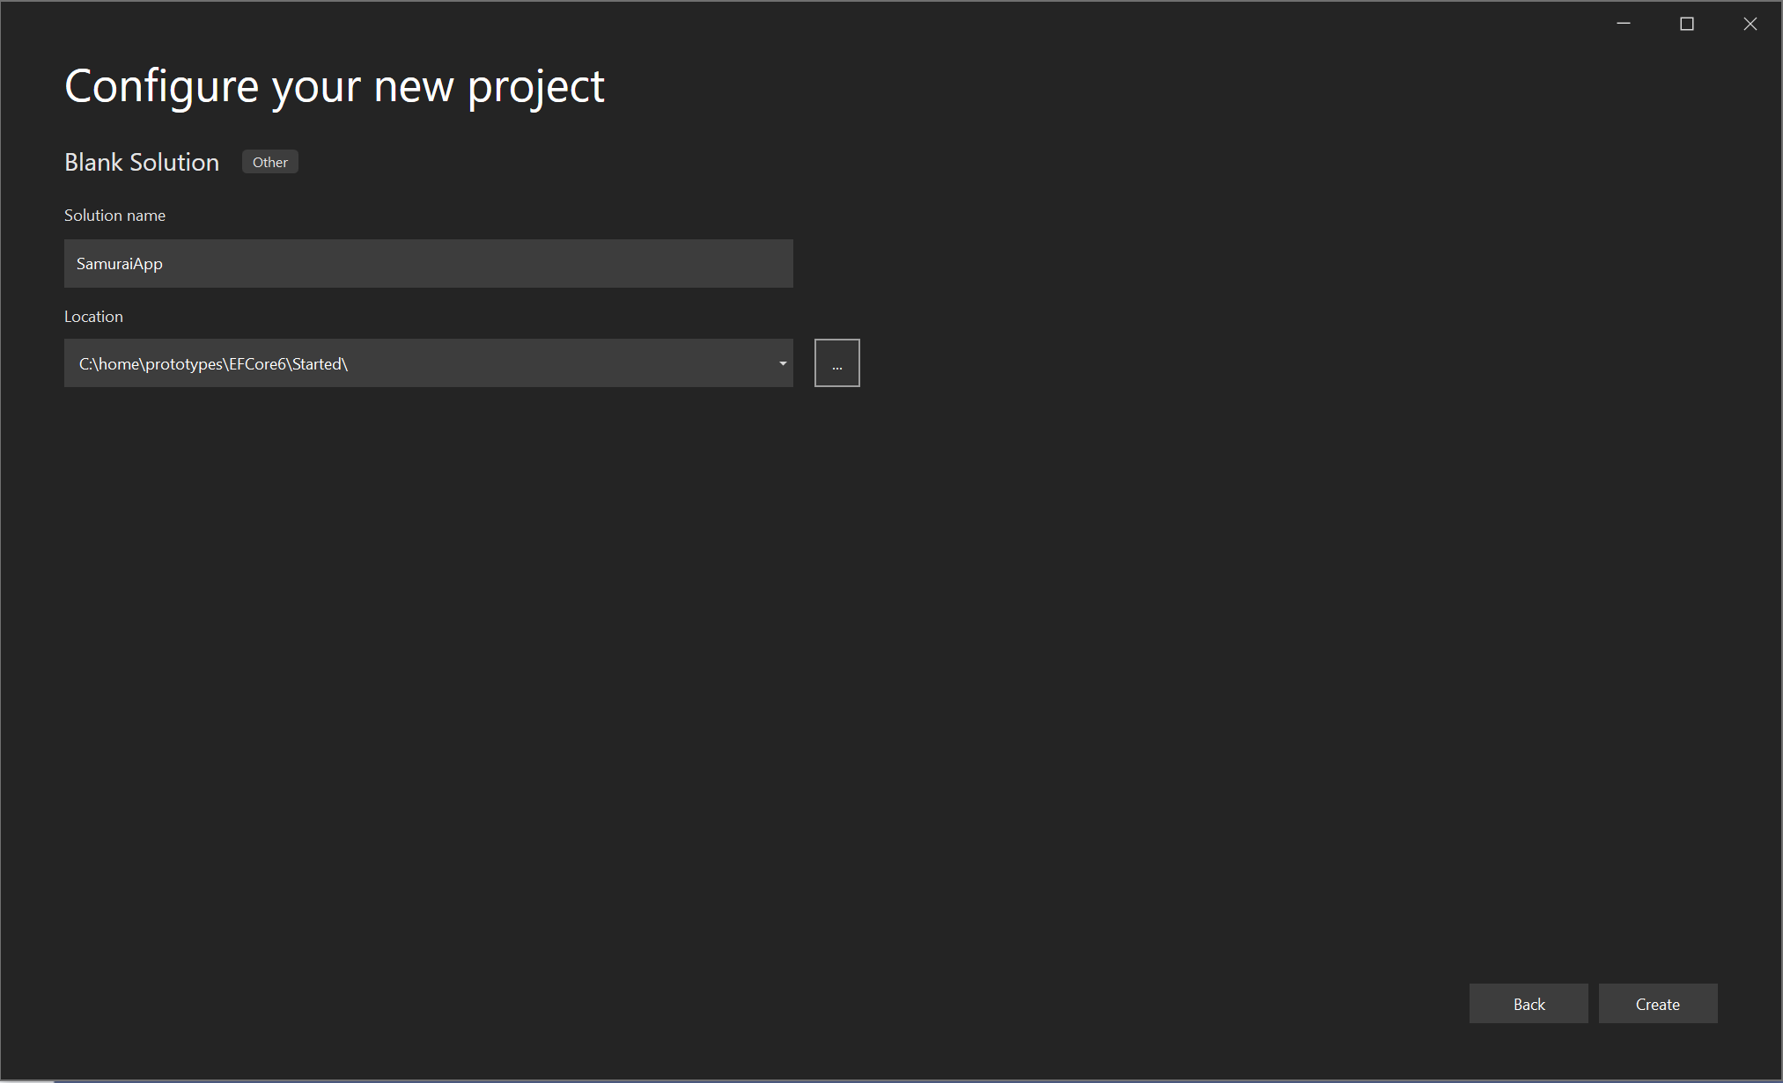
Blank solution

Slide 4
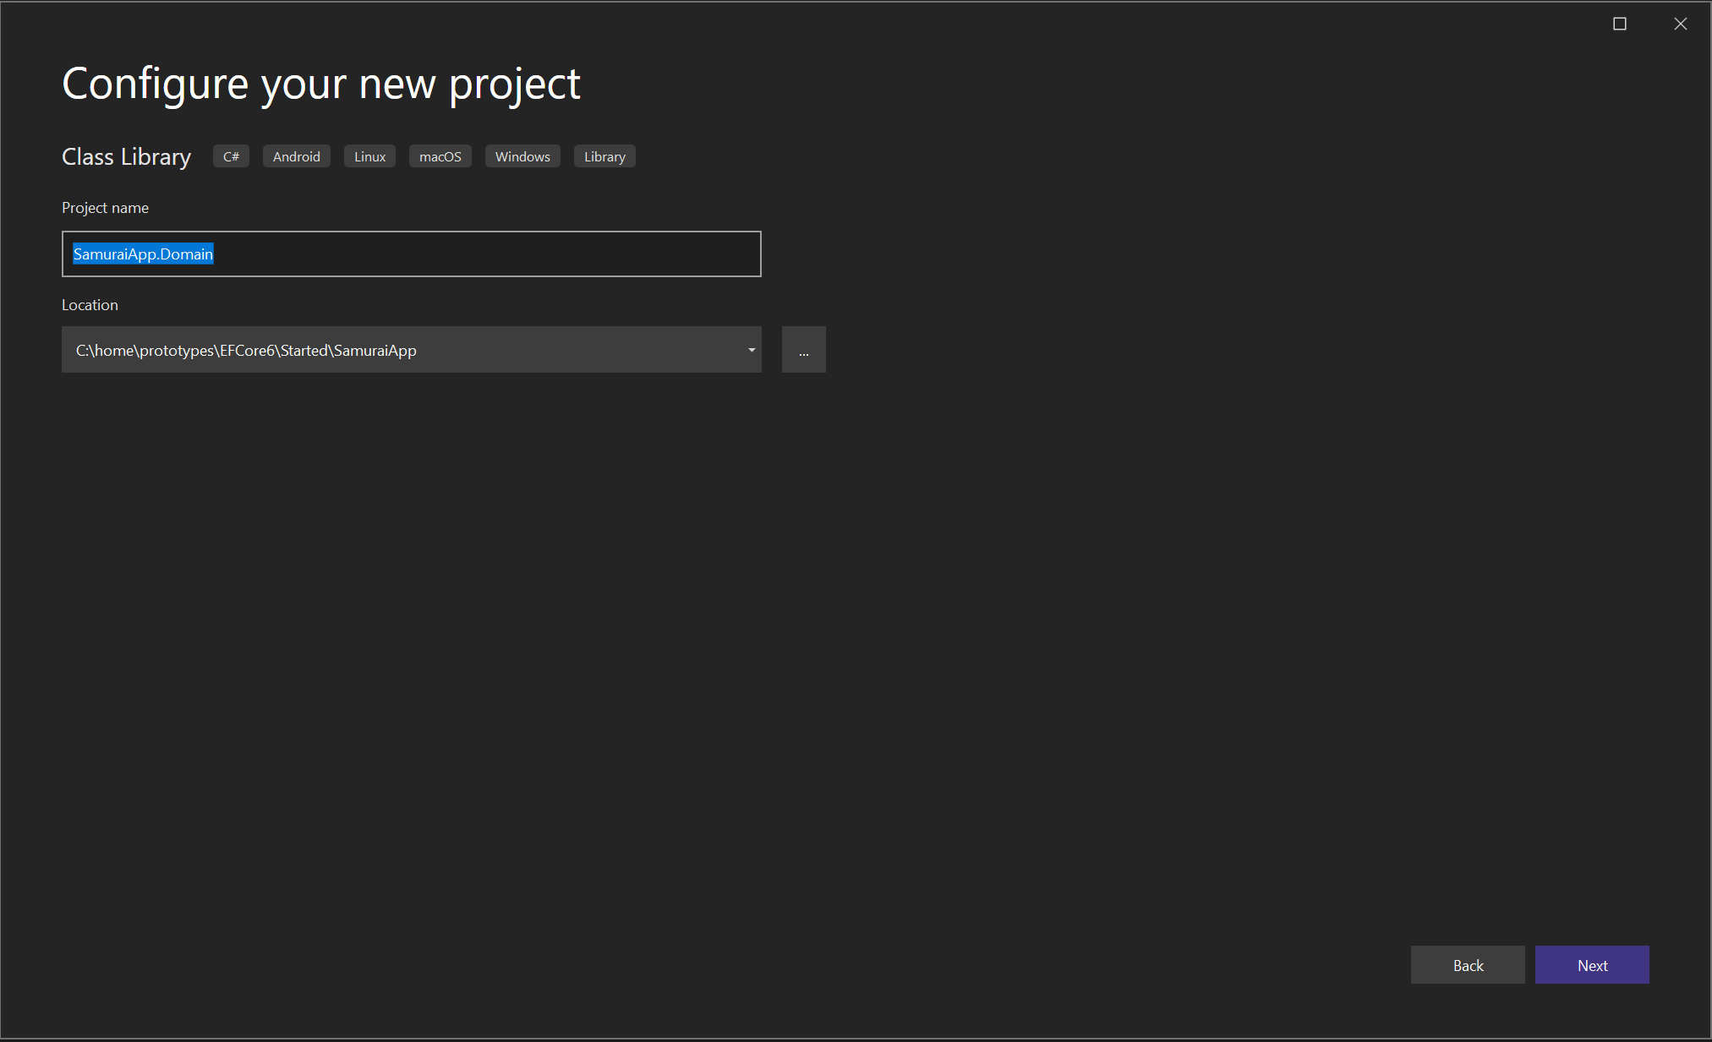
Create domain classes

Slide 5
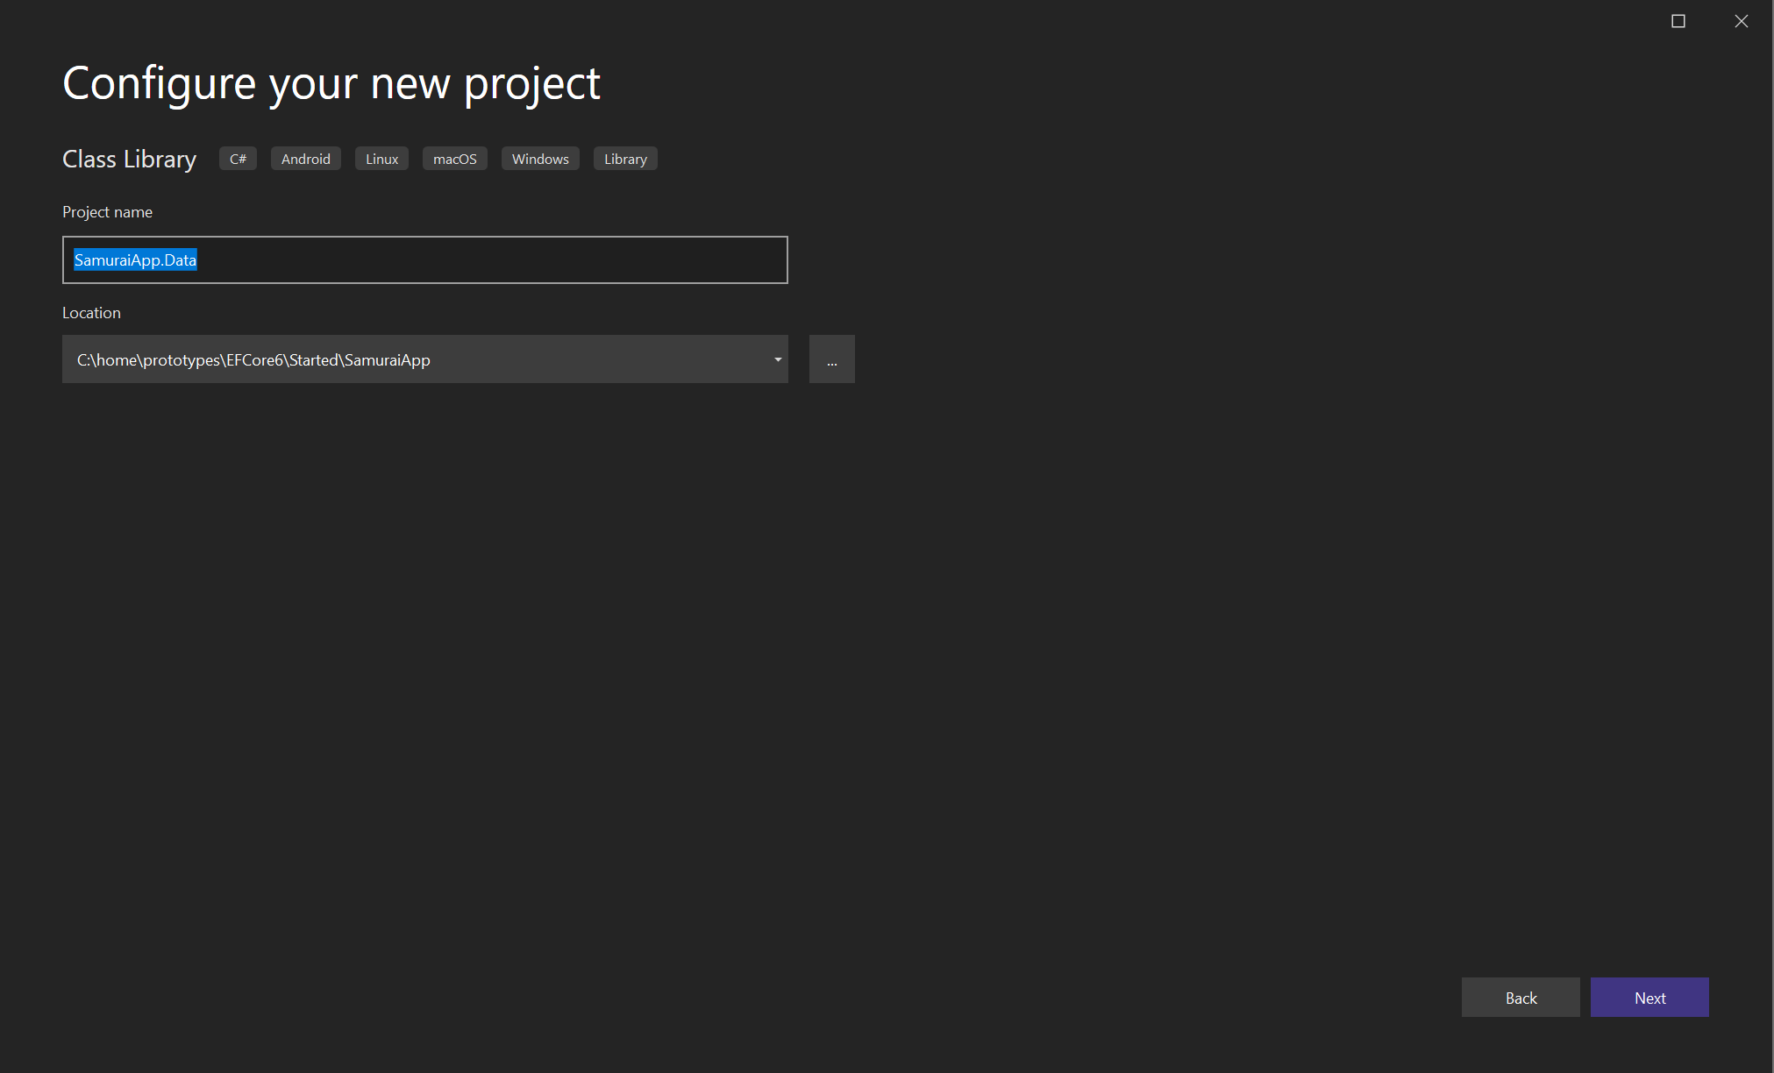
DATA

Slide 6
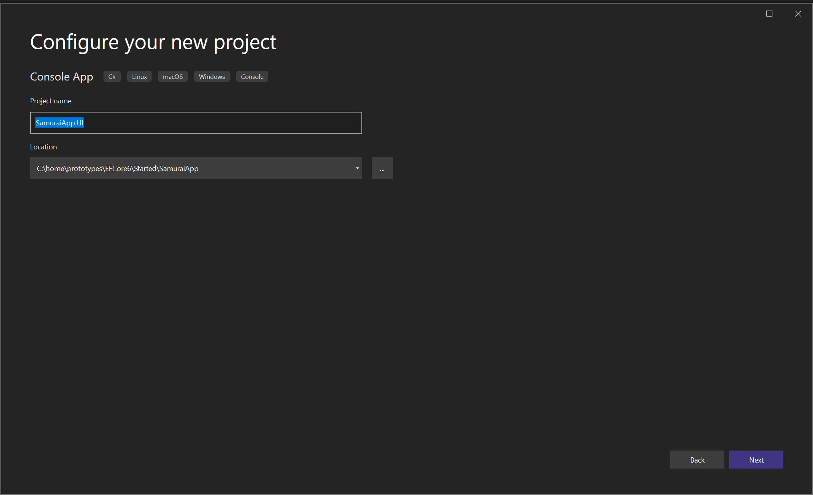
UI

Slide 7
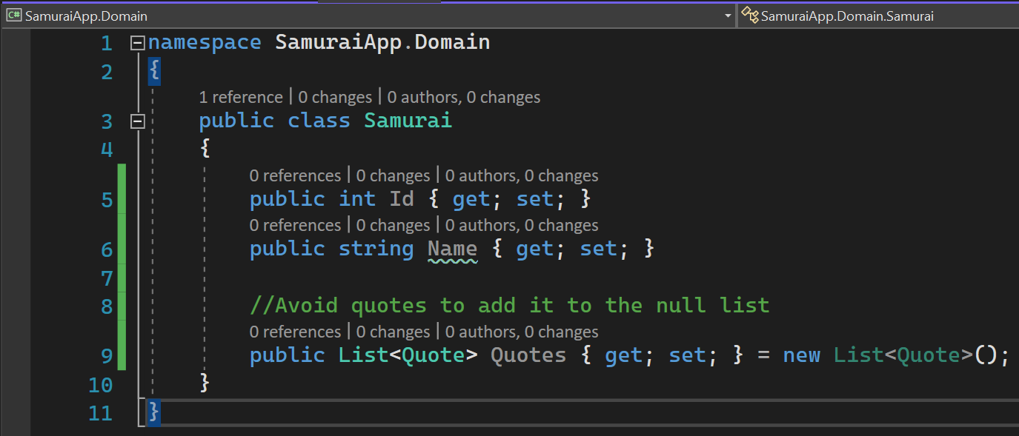
Domain class samurai

Slide 8
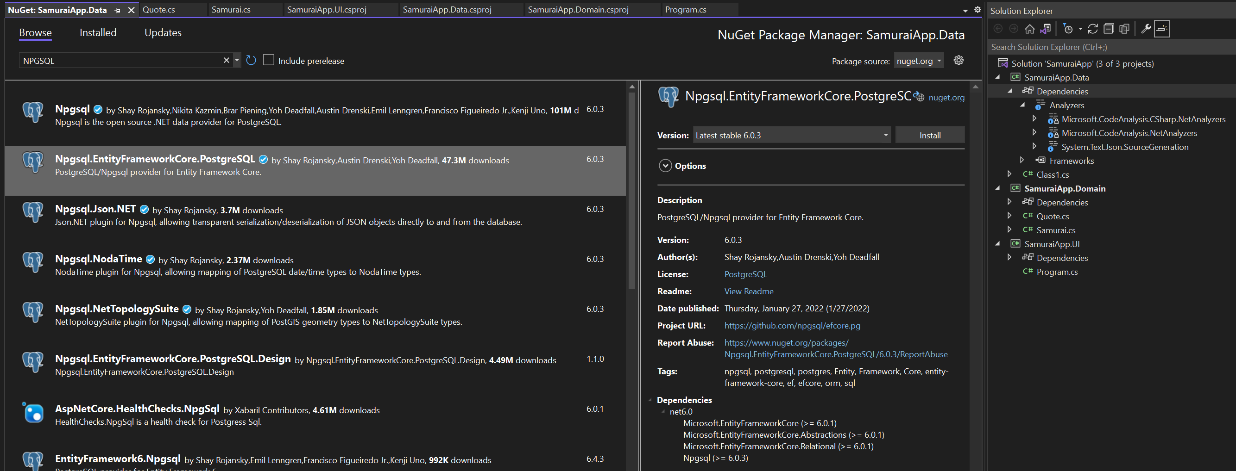
EF CORE

Slide 9
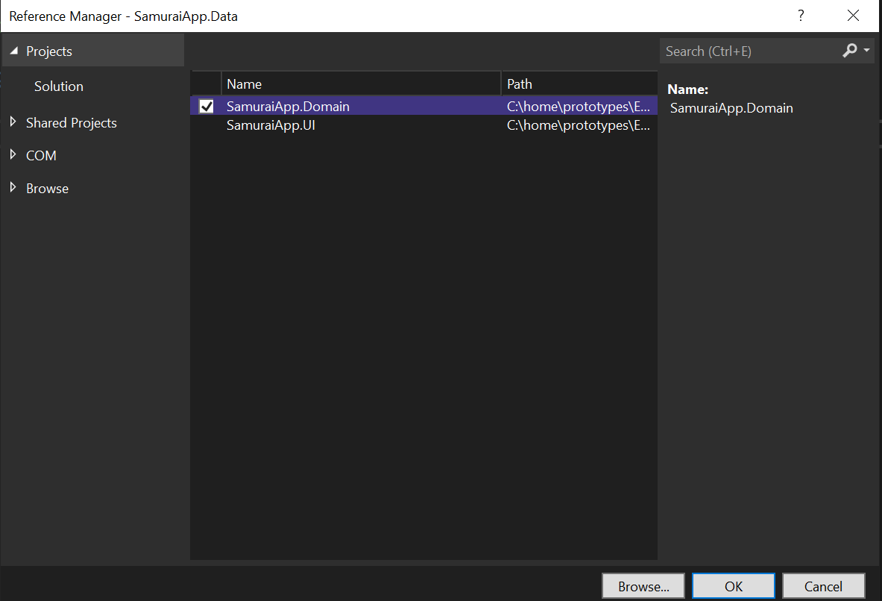
ADD PROJECT REFERENCE

Slide 10
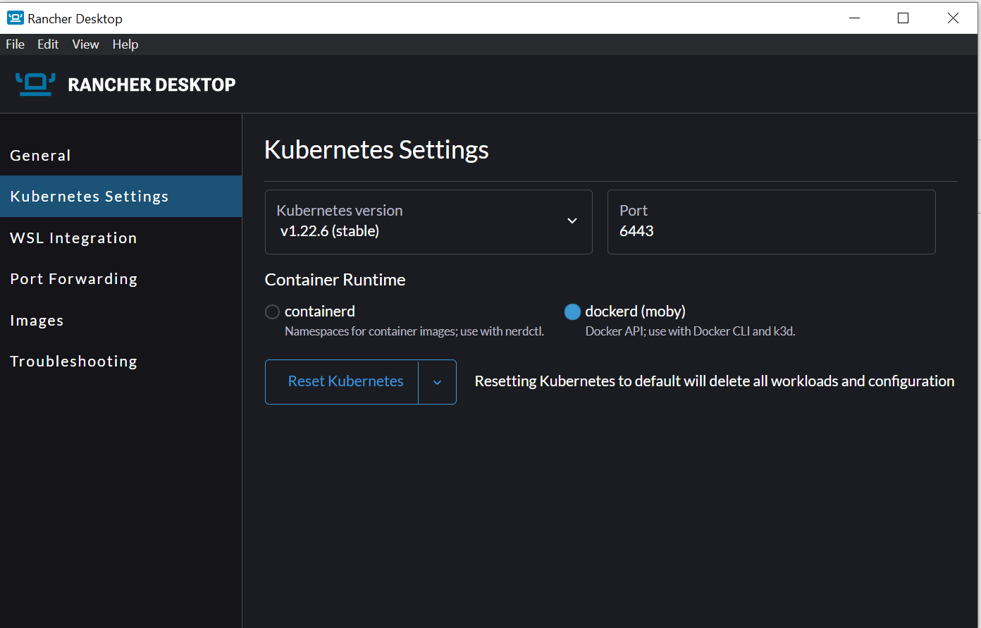
Install rancher
docker run --name postgres_proto -e POSTGRES_PASSWORD=sandeep -p 5435:5432 -d postgres

Slide 11
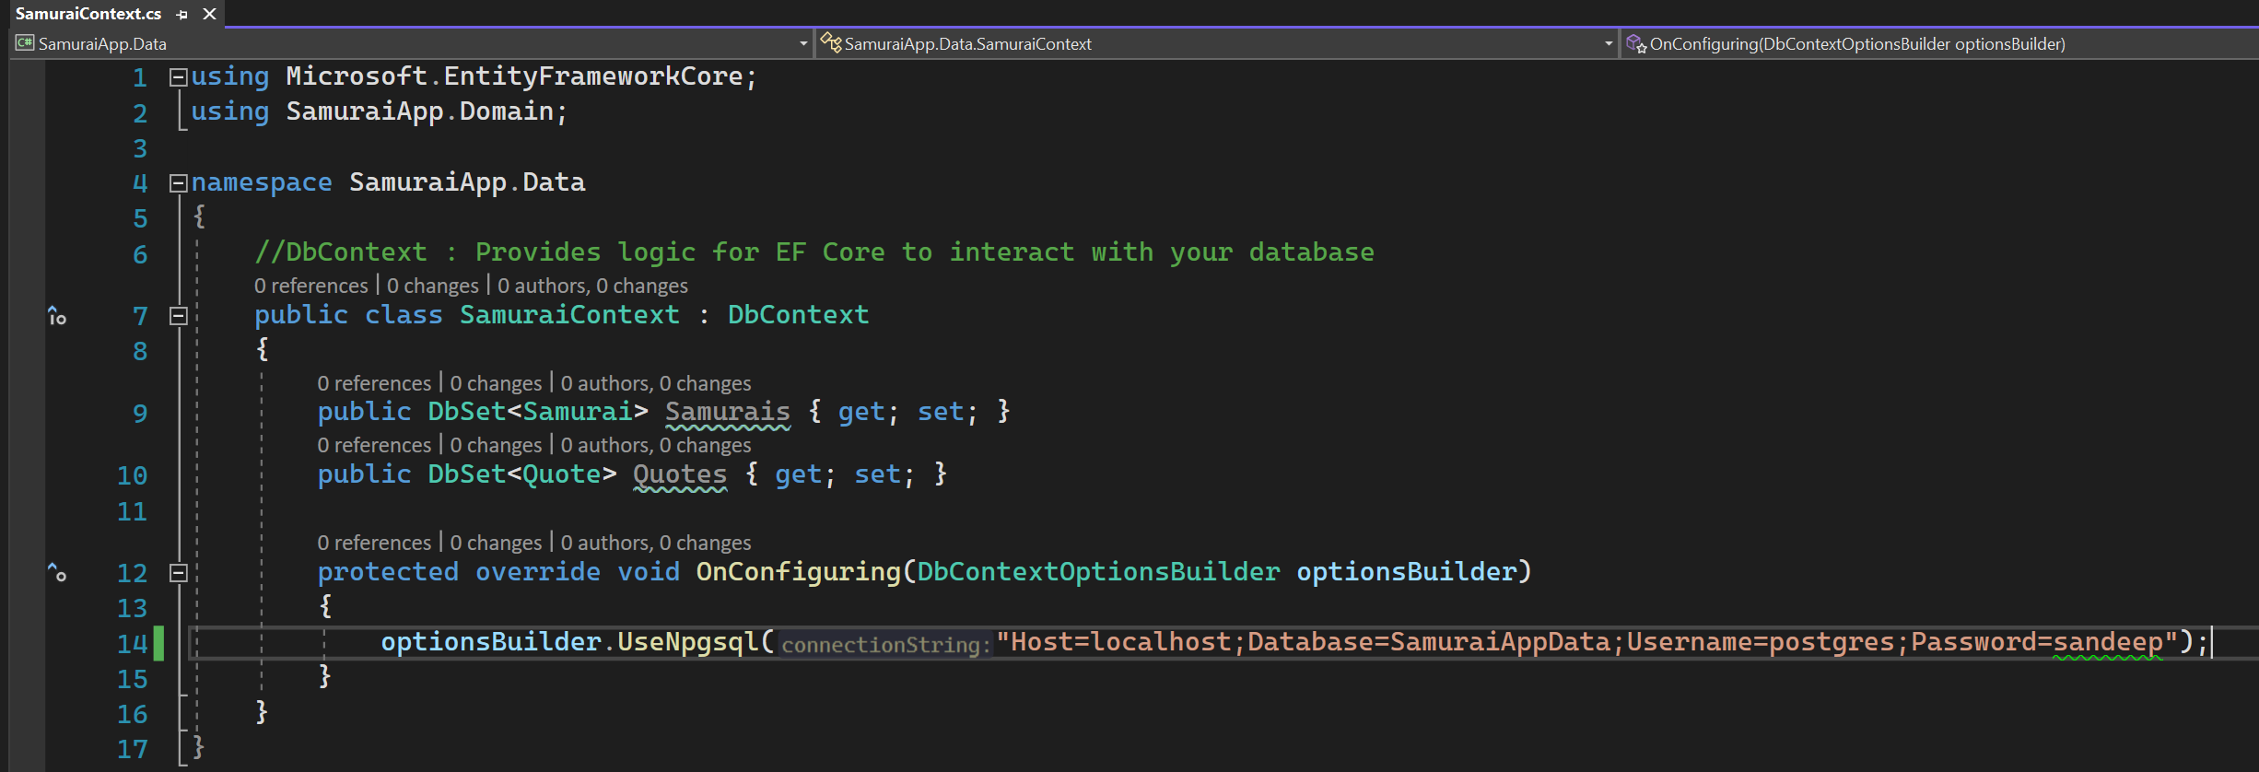
Samurai context

Slide 12
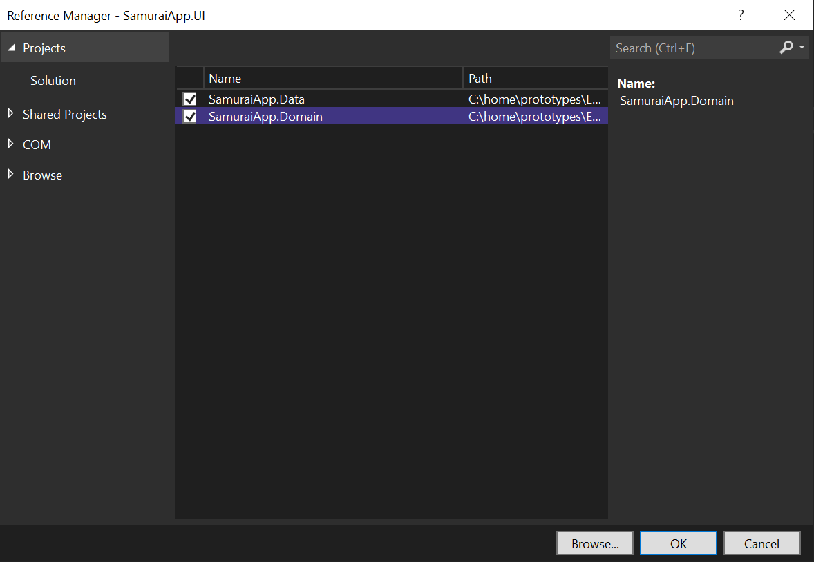
Adding context

Slide 13
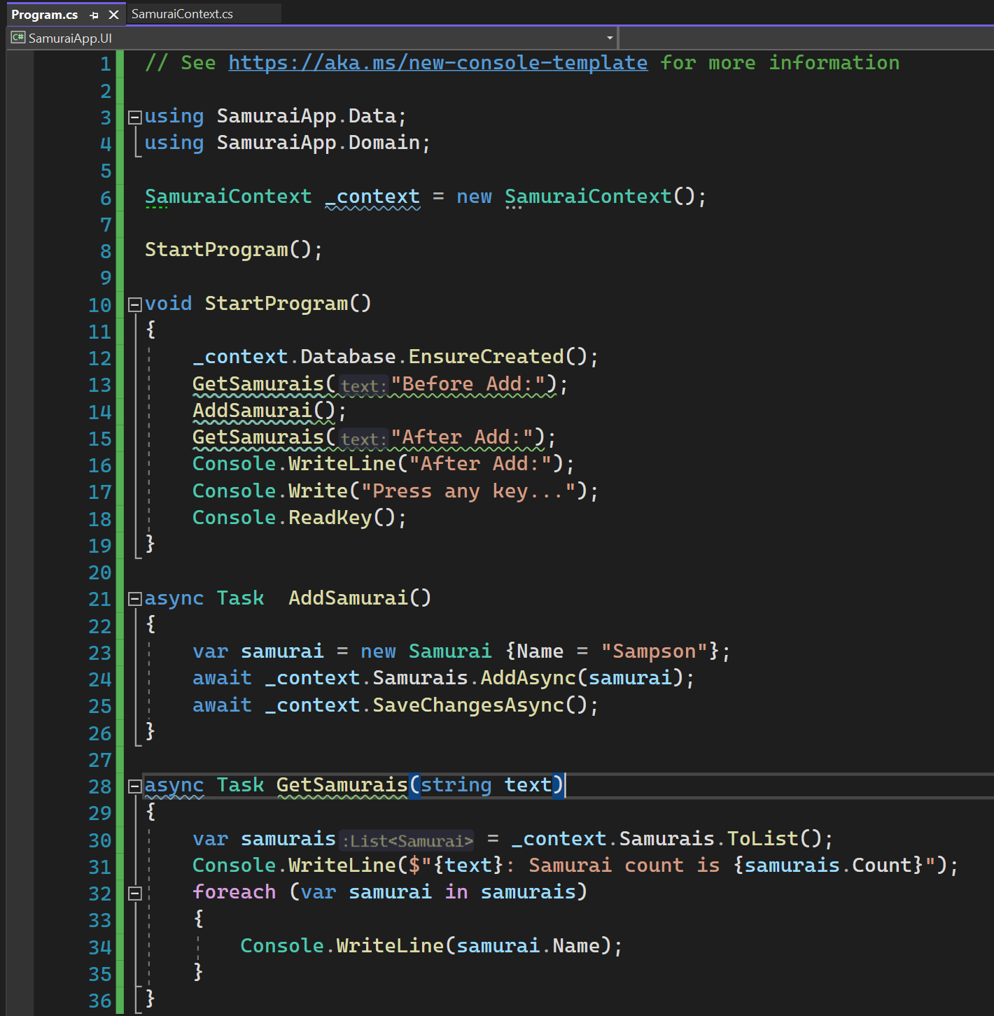
SAMURAI UI

Slide 14
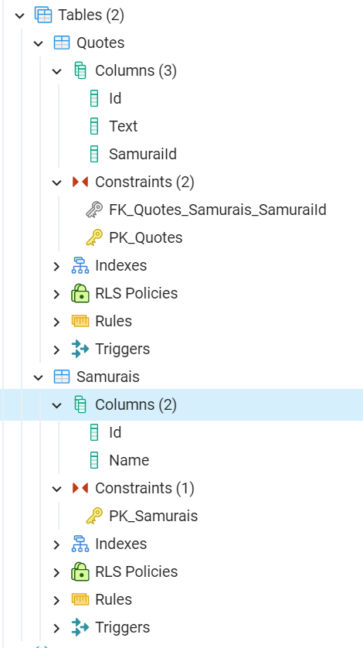
Constraints

Slide 15
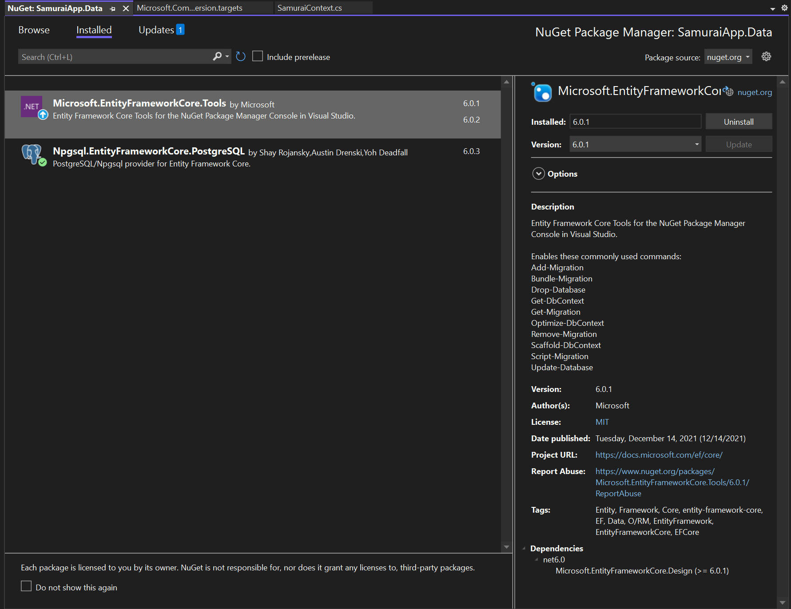
Add Microsoft.entityframework.core.tools

Slide 16
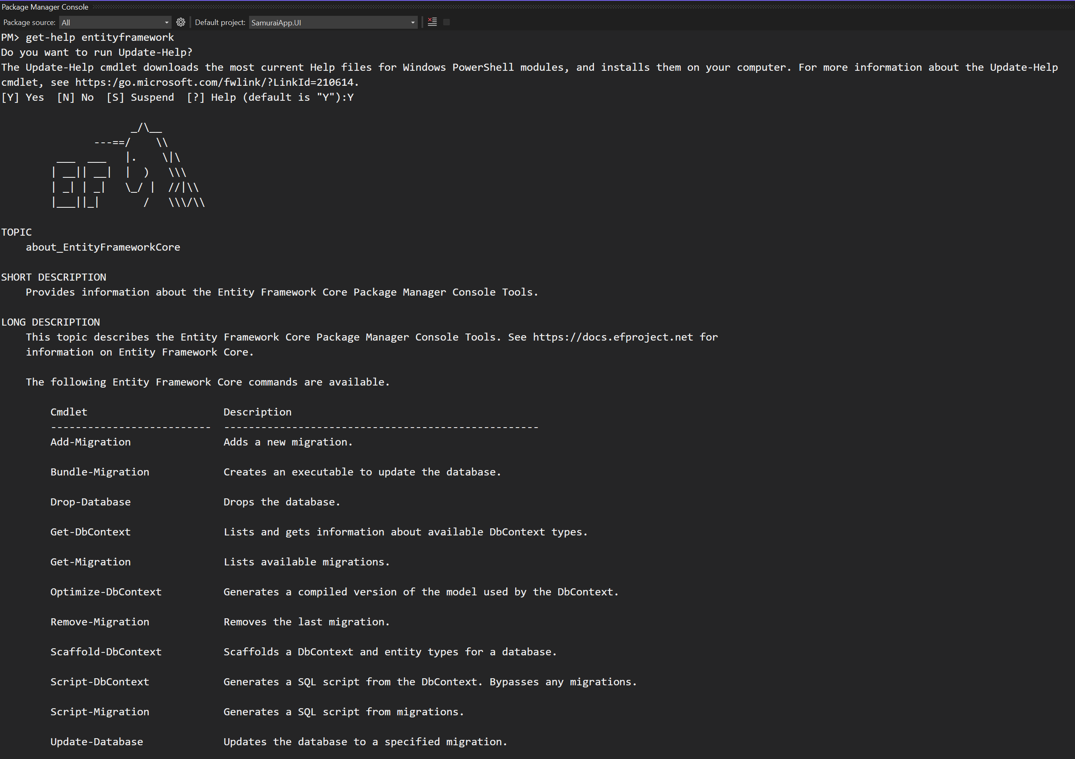
Get-help entity FRAMEWork - 1

Slide 17
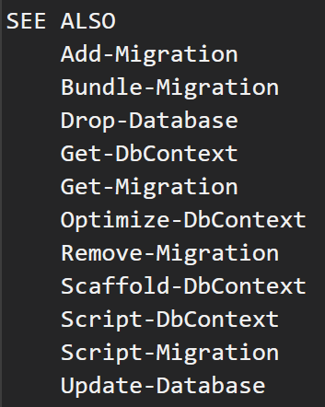
Get-help entity Framework - 2

Slide 18
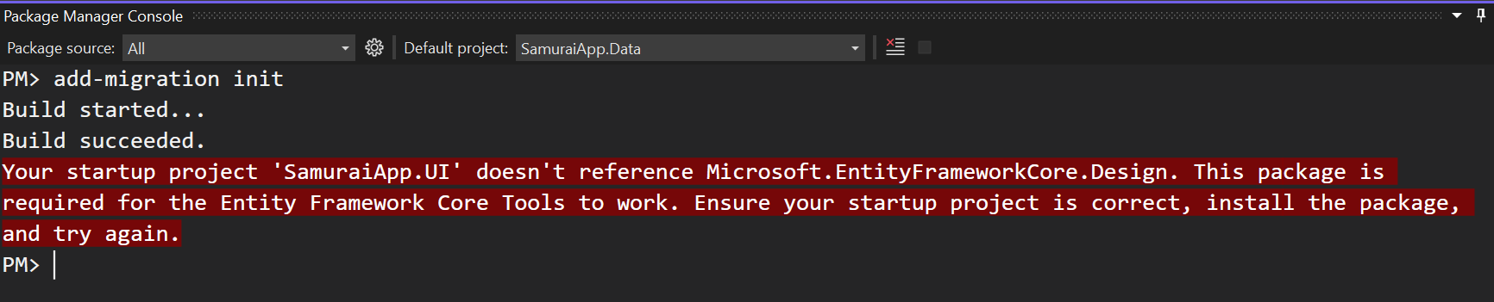
Get-help entity Framework - 3

Slide 19
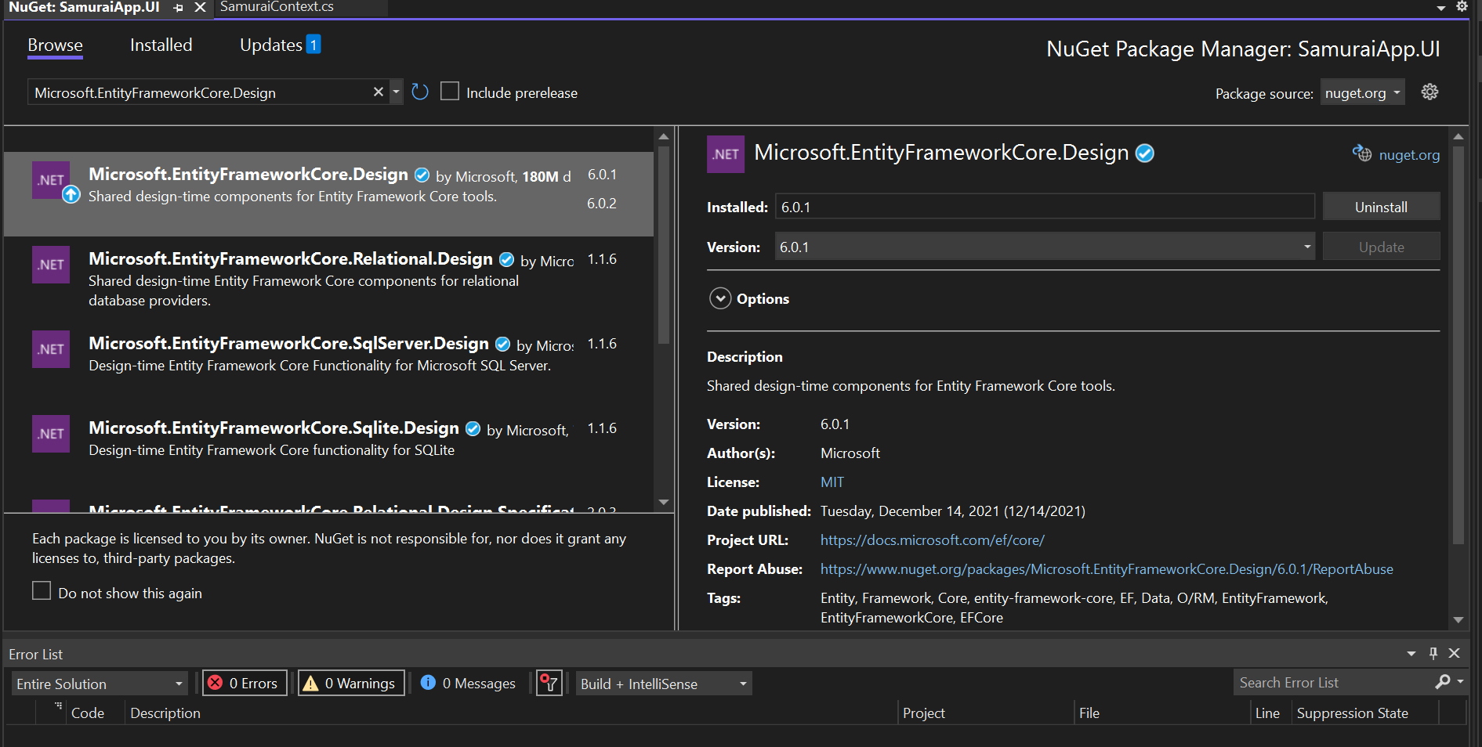
Add in the UI

Slide 20
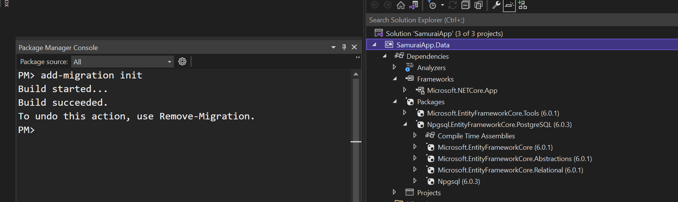
Add migration

Slide 21
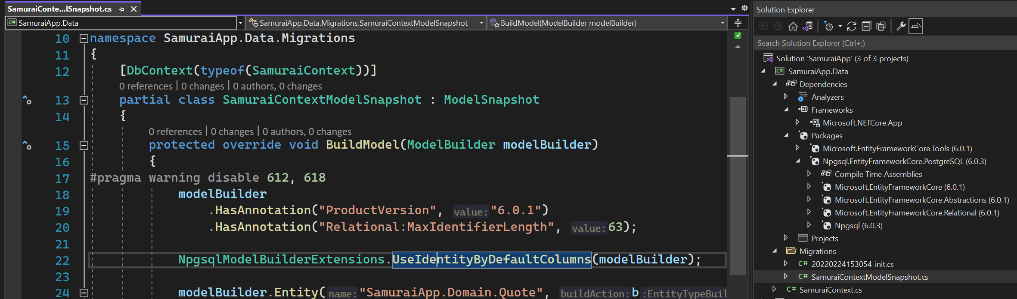
Snapshot
The snapshot is used to determine how to migrate from one model version to next.

Slide 22
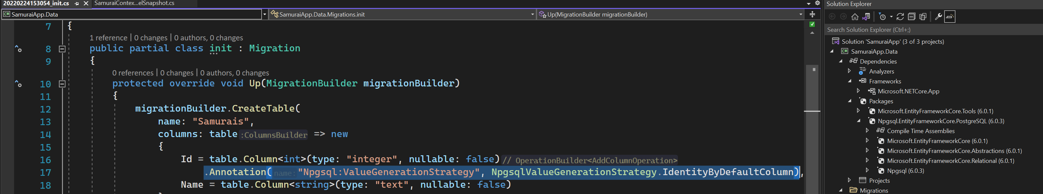
Migration code - Identity column

Slide 23
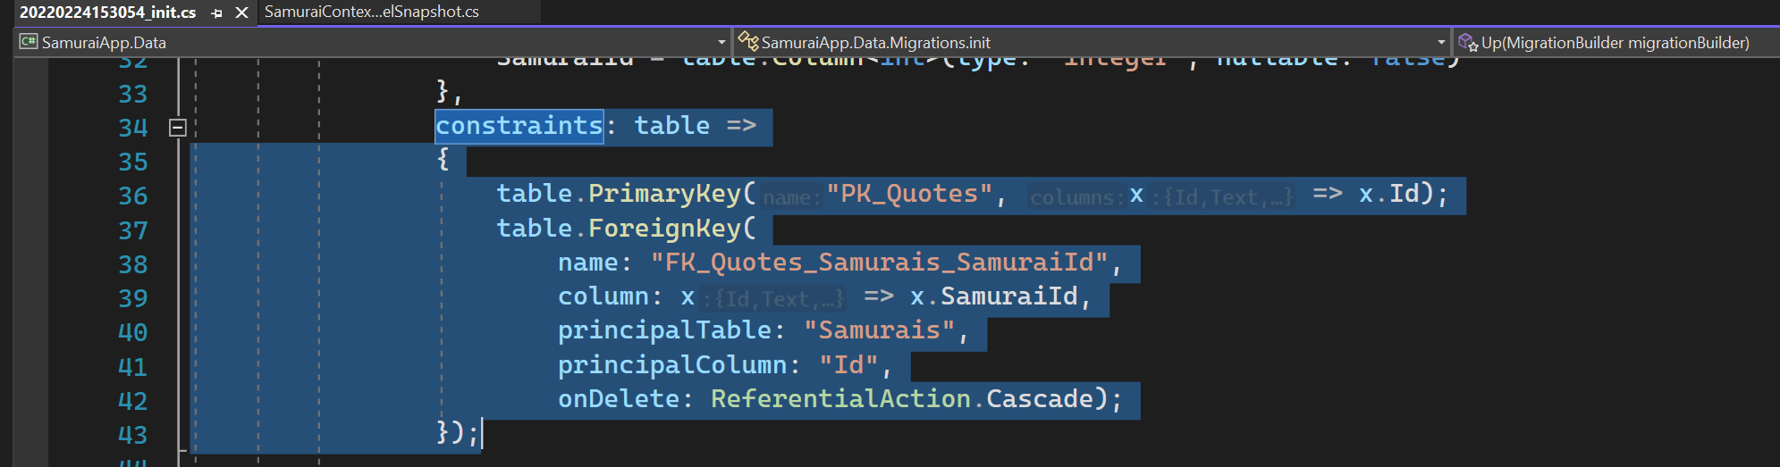
Migration code - constraints
EF Core recognized one to many relationship

Slide 24
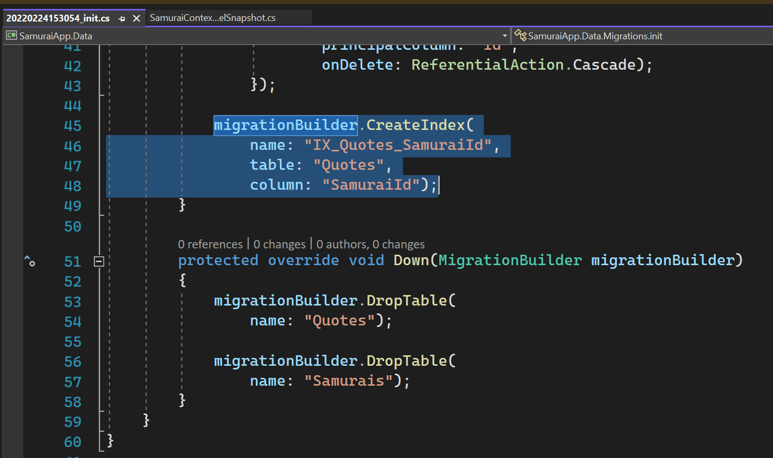
Migration code - index
Create index for foreign key that discovers on the model.

Slide 25
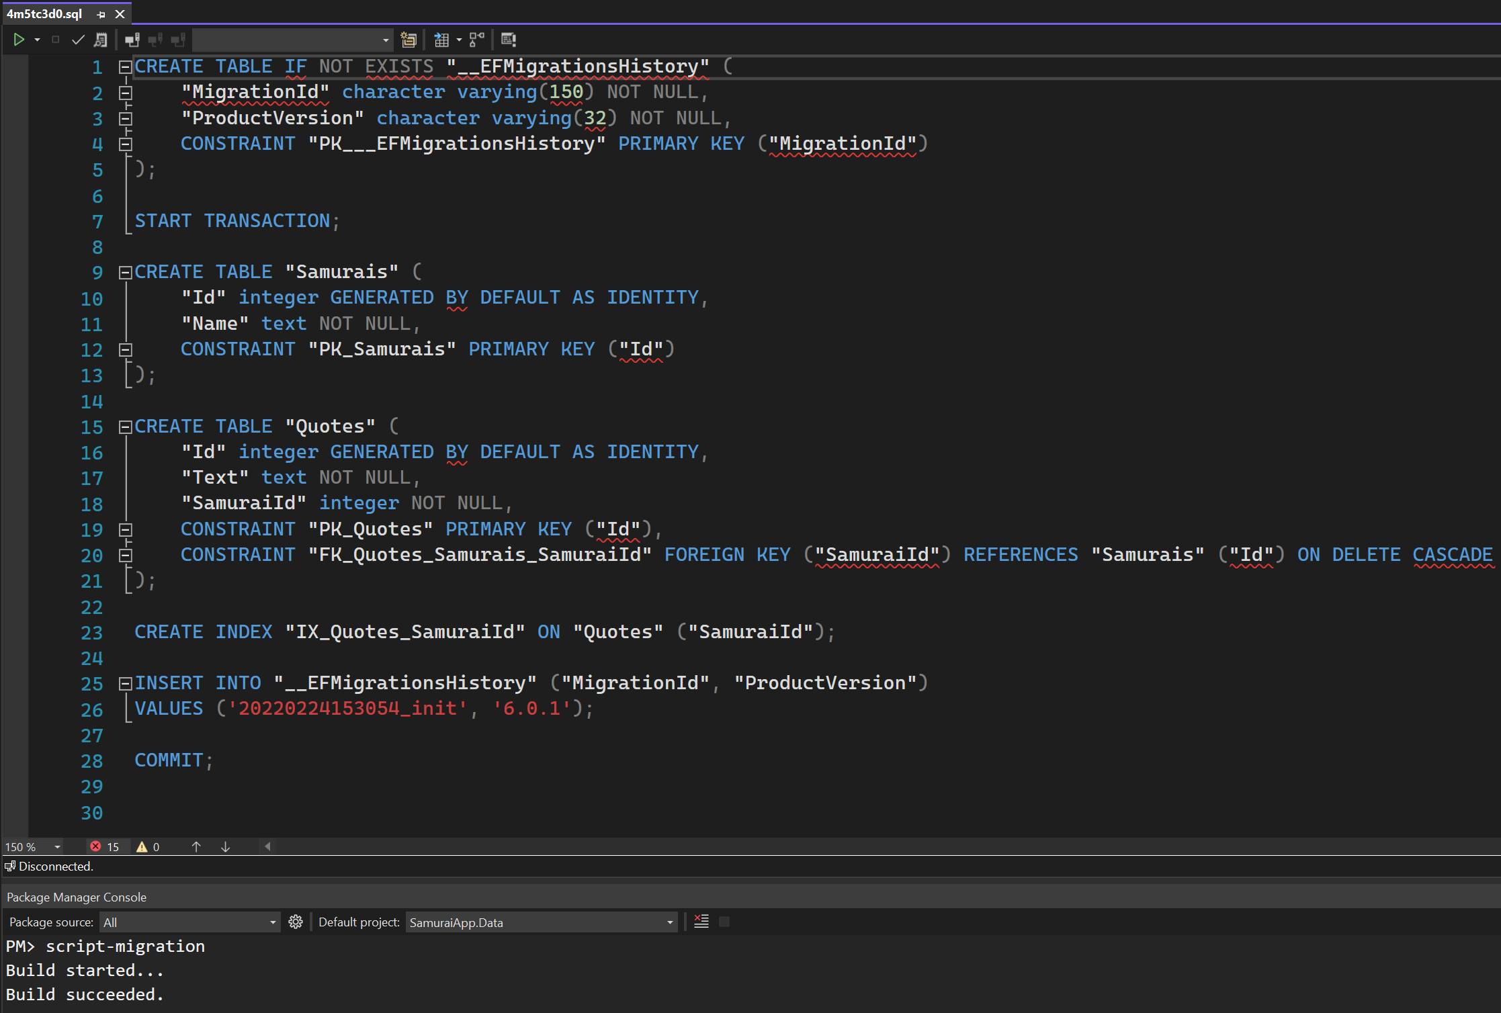
Script migration

Slide 26
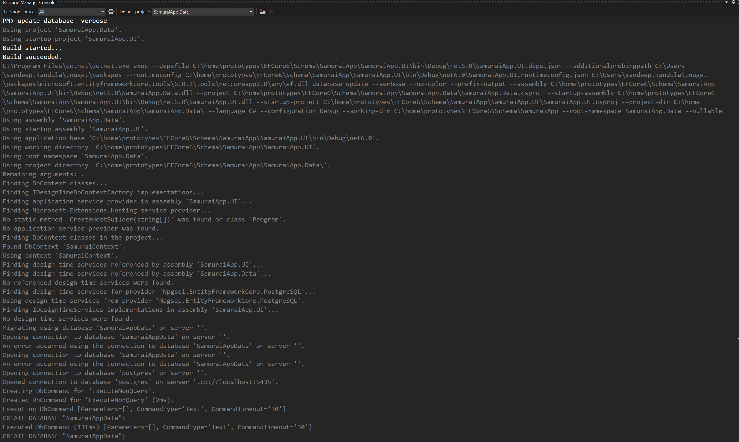
Update-database

Slide 27
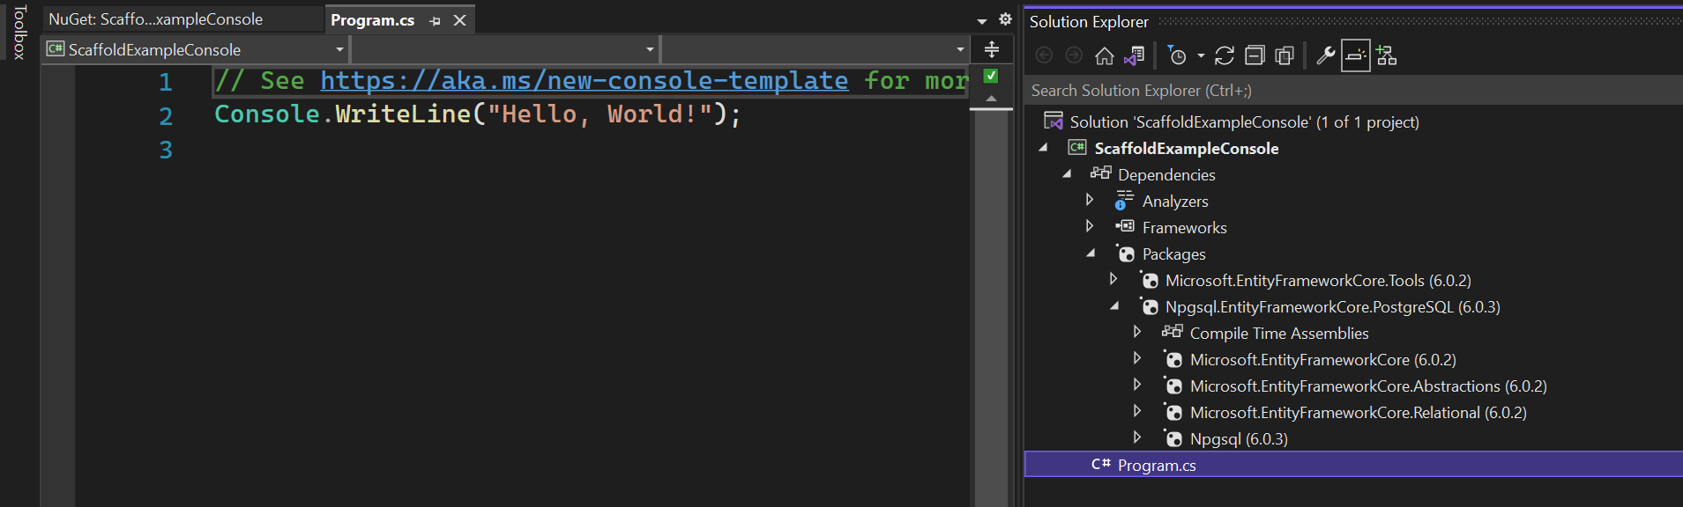
ReverSe engineer an existing database - 1
https://cmatskas.com/ef-core-migrations-with-existing-database-schema-and-data/

Slide 28
ReverSe engineer an existing database - 2
https://cmatskas.com/ef-core-migrations-with-existing-database-schema-and-data/

Slide 29
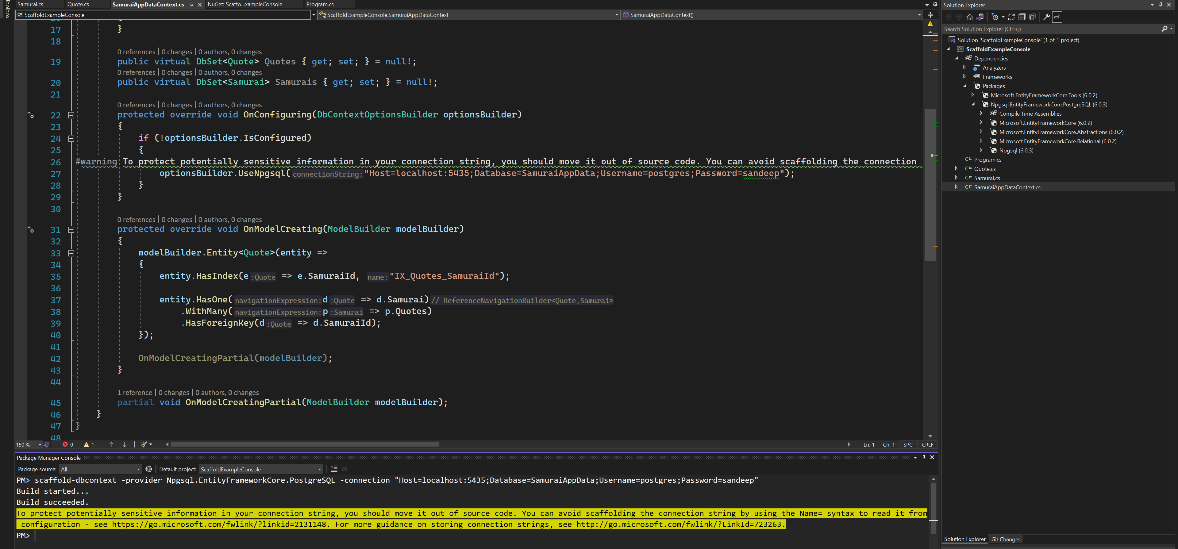
ReverSe engineer an existing database - 3

Slide 30
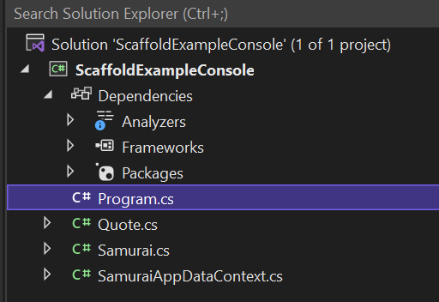
EF Core 6
EF Core 6 scaffolding now defaults to creating singular names for the entity classes.

Slide 31
Defining relationships in model

Slide 32
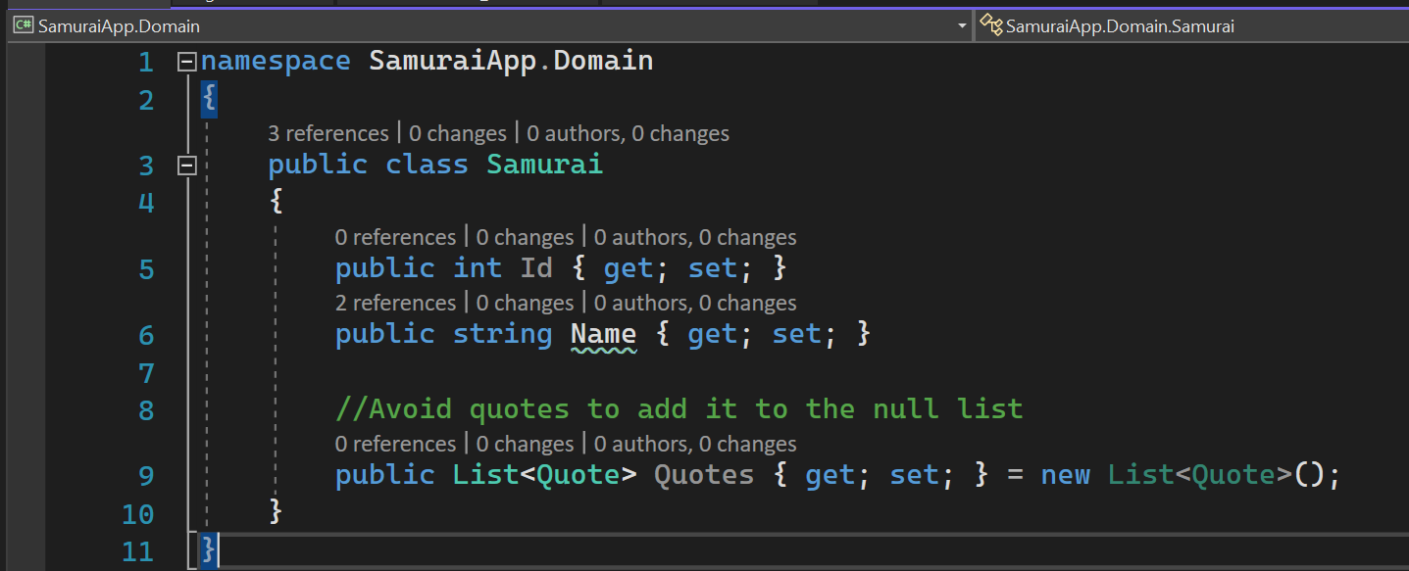
One to Many relationship
EF Core will also recognize Collection<T> and Enumerable<T>

Slide 33
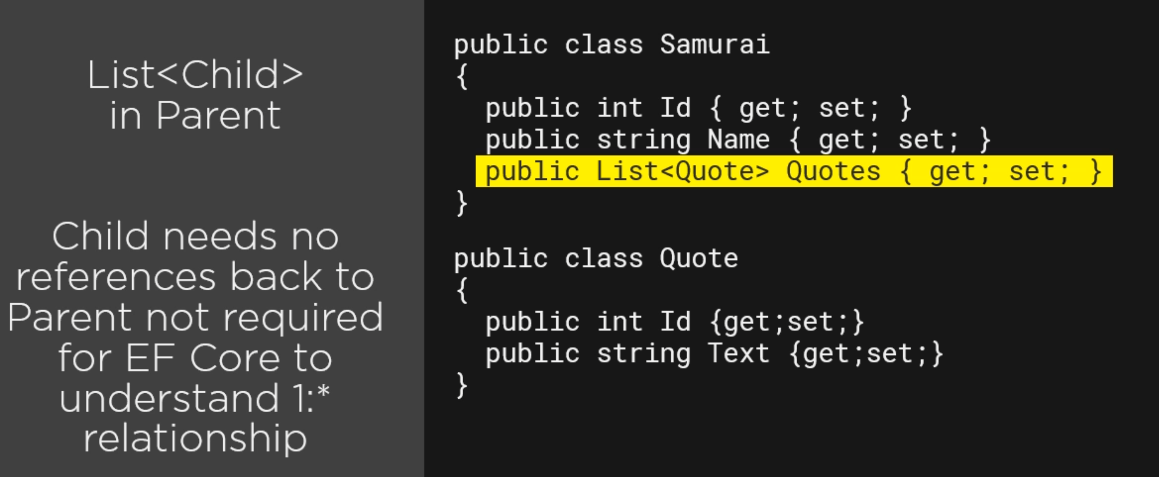
1: * :Relation Type 1

Slide 34
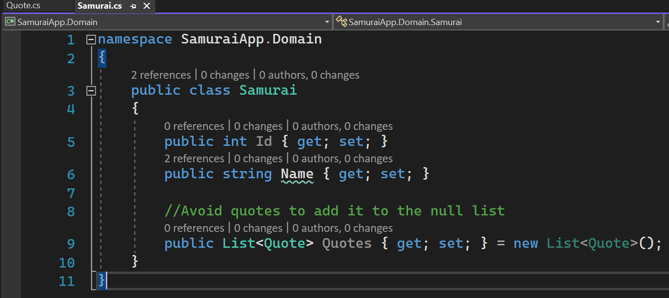
1: * Relation Type 1 - 1

Slide 35
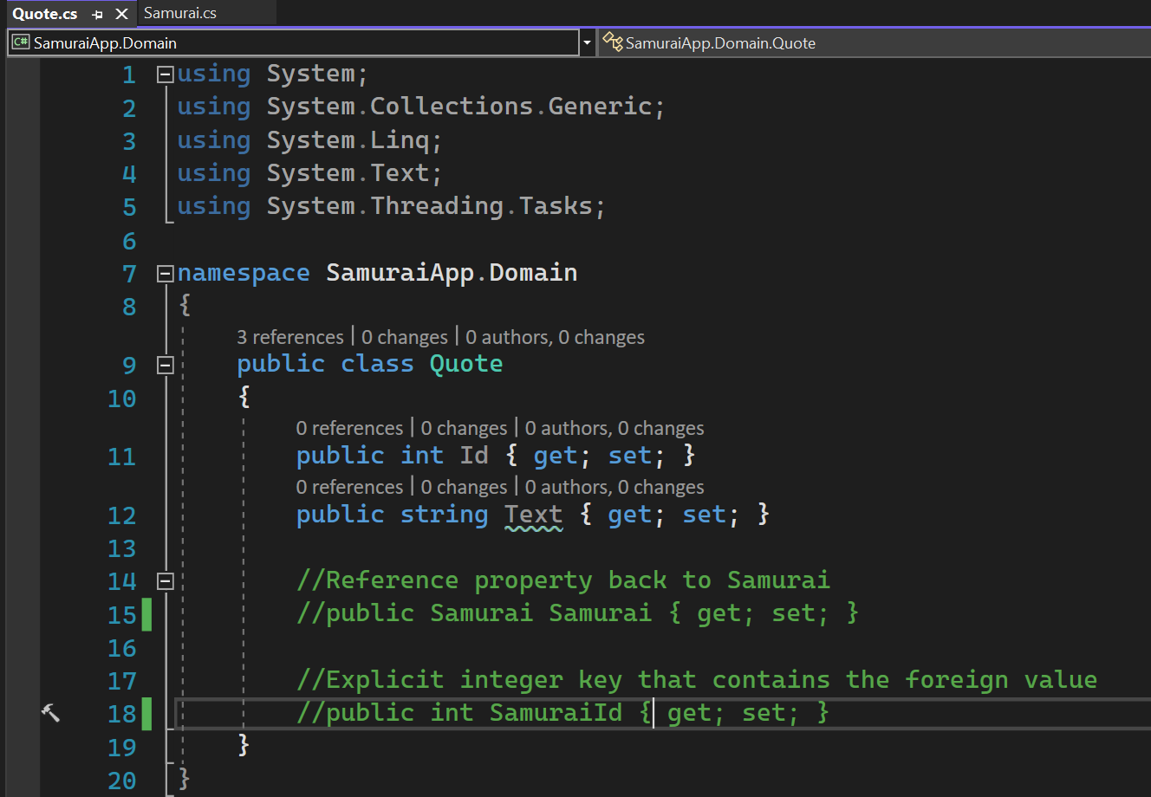
1: * Relation Type 1 - 2

Slide 36
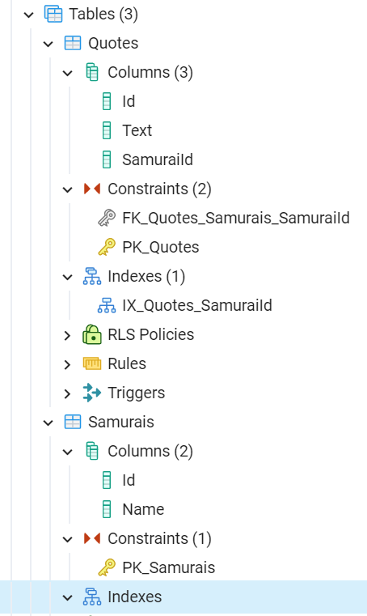
1: * CONSTRAINTS

Slide 37
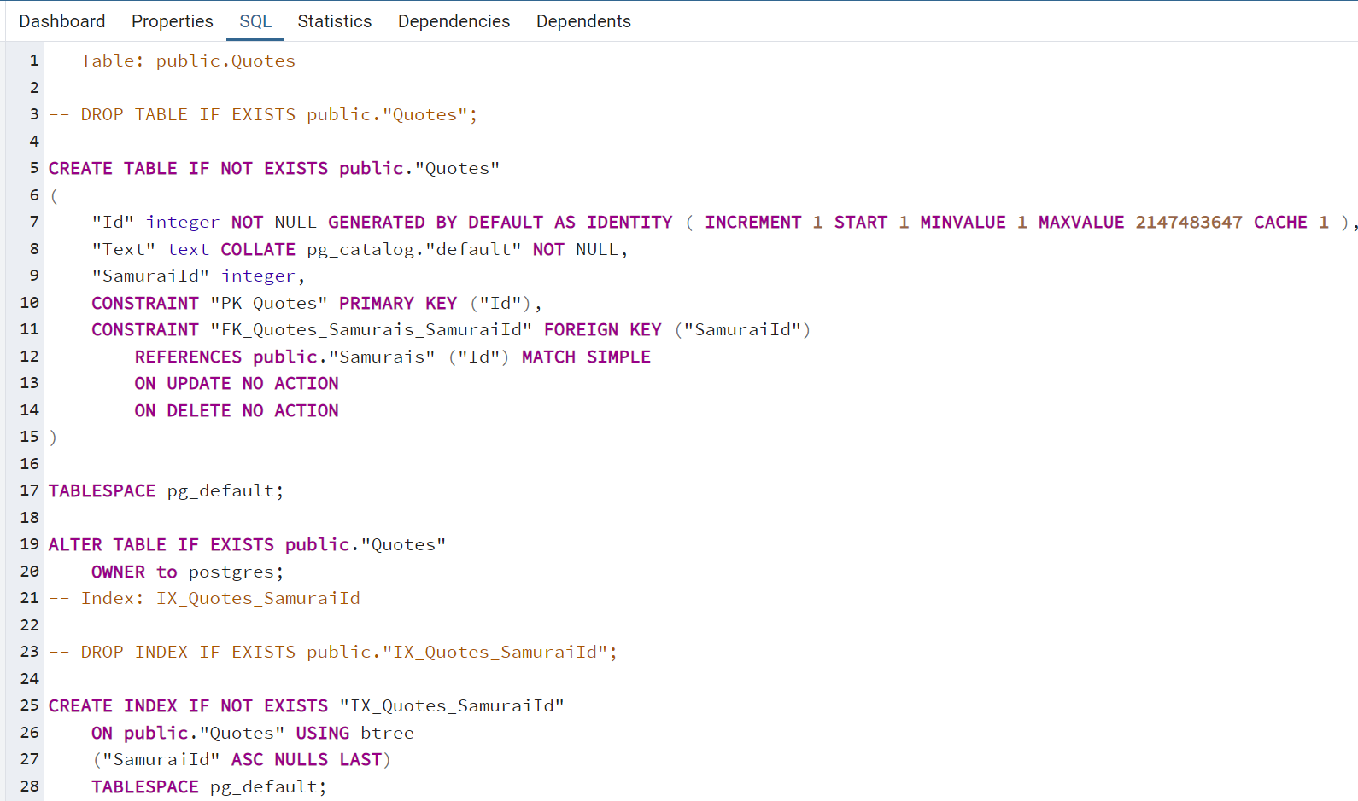
1: * CONSTRAINTS

Slide 38
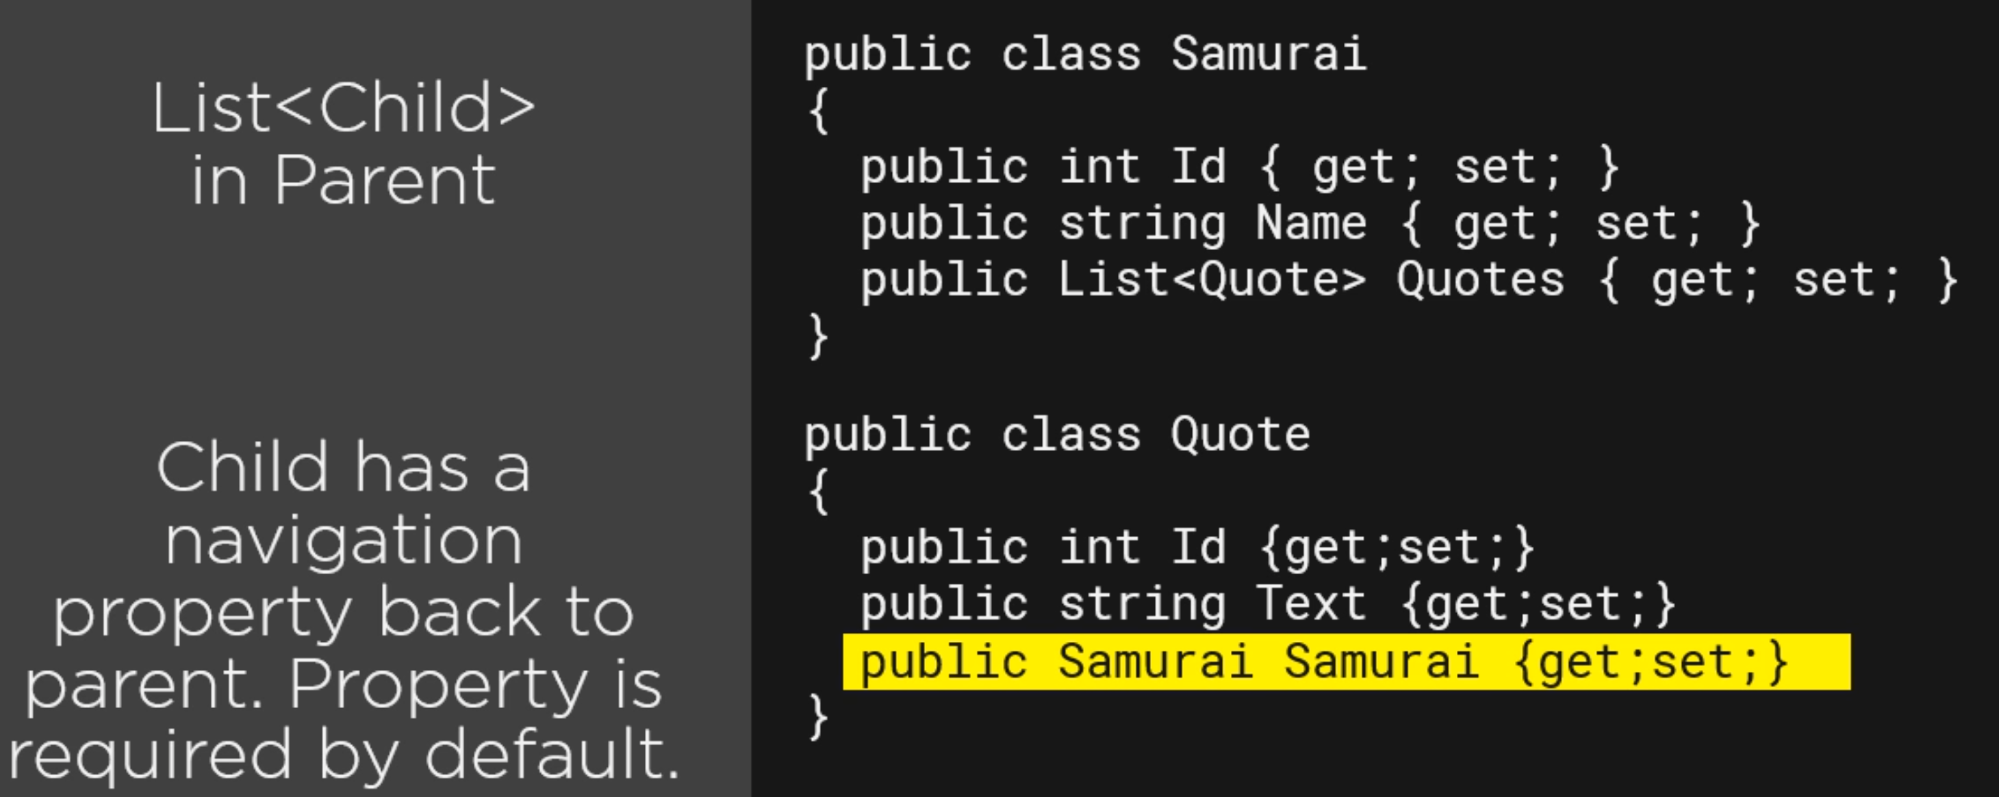
1: * Relation type 2
Samurai can be null and therefore a quote can exist without Samurai.

Slide 39
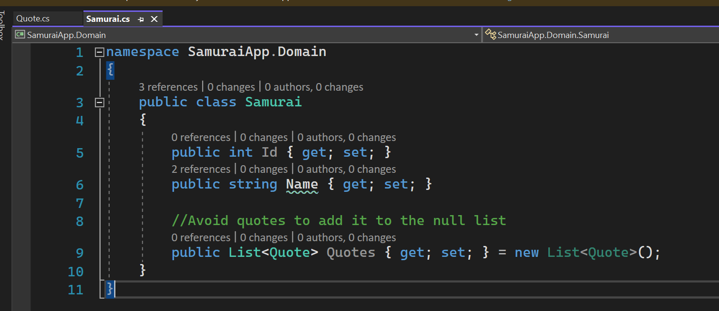
1: * Relation type 2 - 1

Slide 40
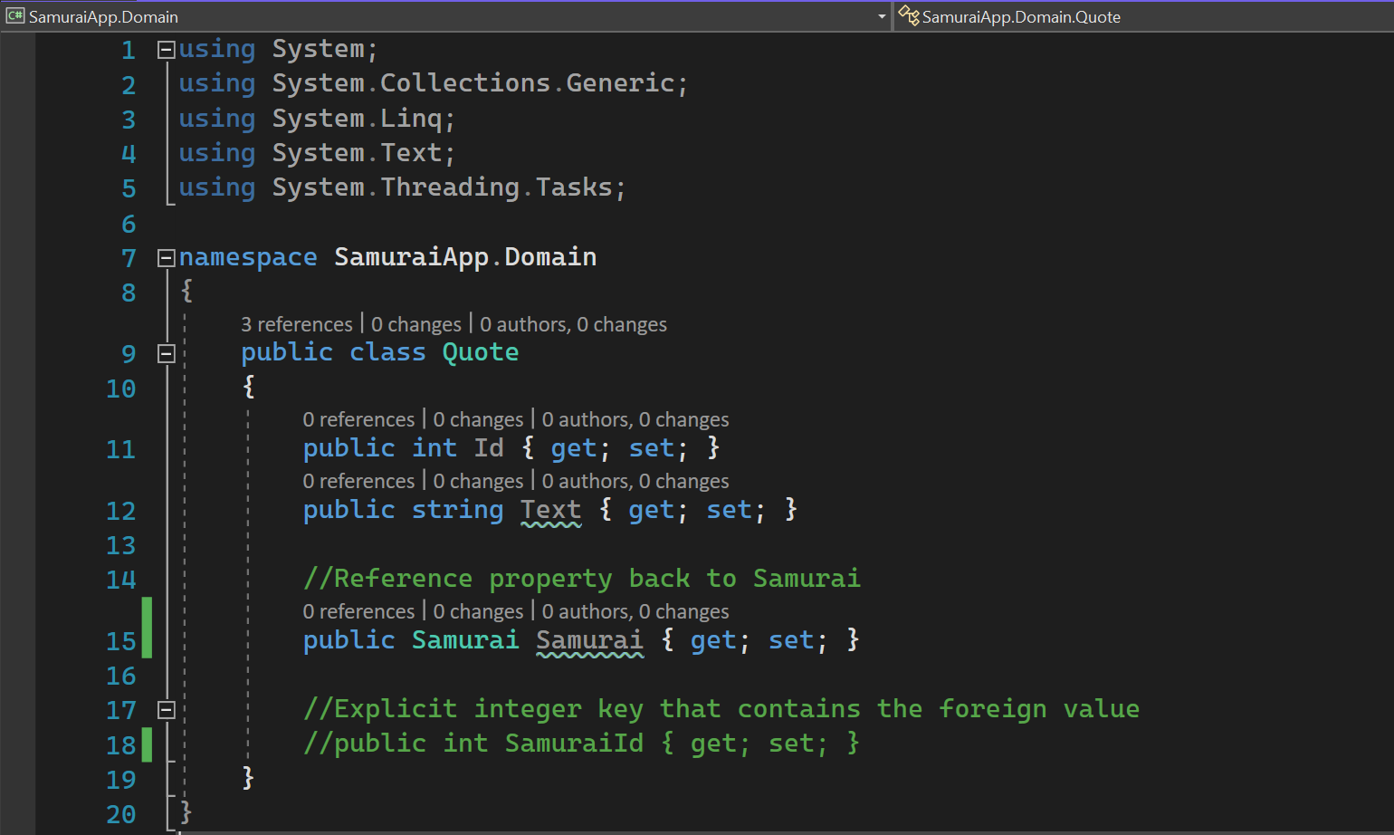
1: * Relation type 2 - 2

Slide 41
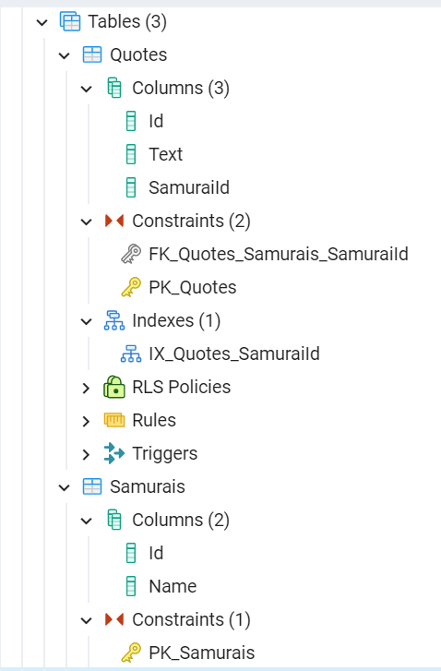
1: * Constraints 1

Slide 42
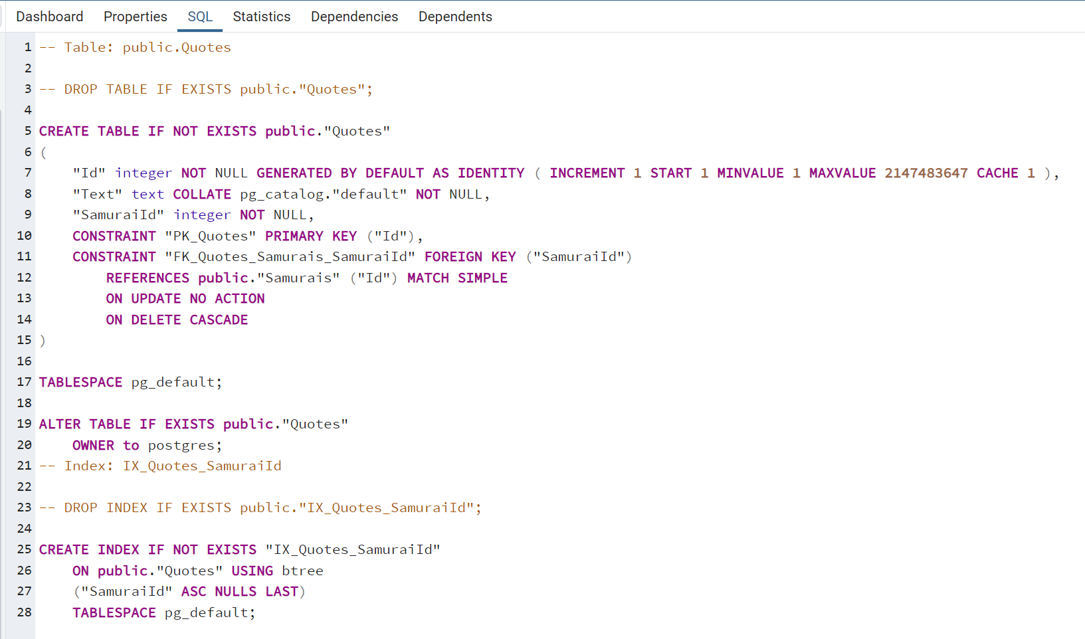
1: * Constraints 2

Slide 43
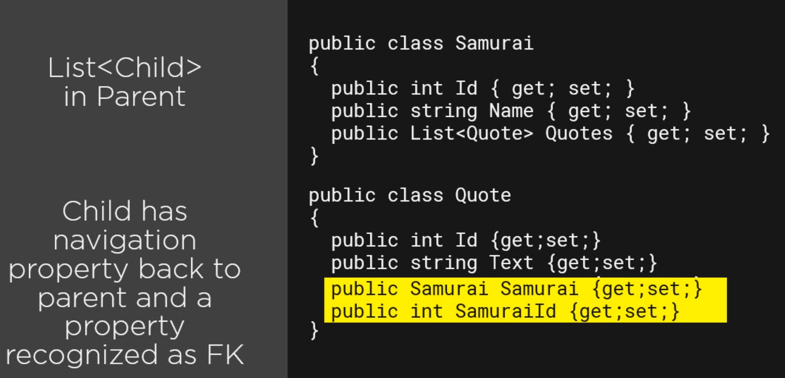
1: * Relation type 3

Slide 44
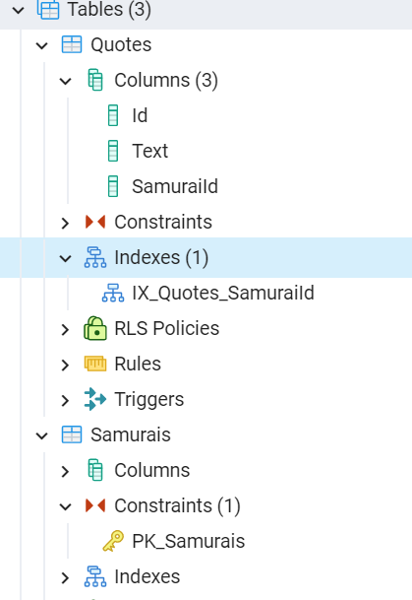
1: * CONSTRIANTS -1

Slide 45
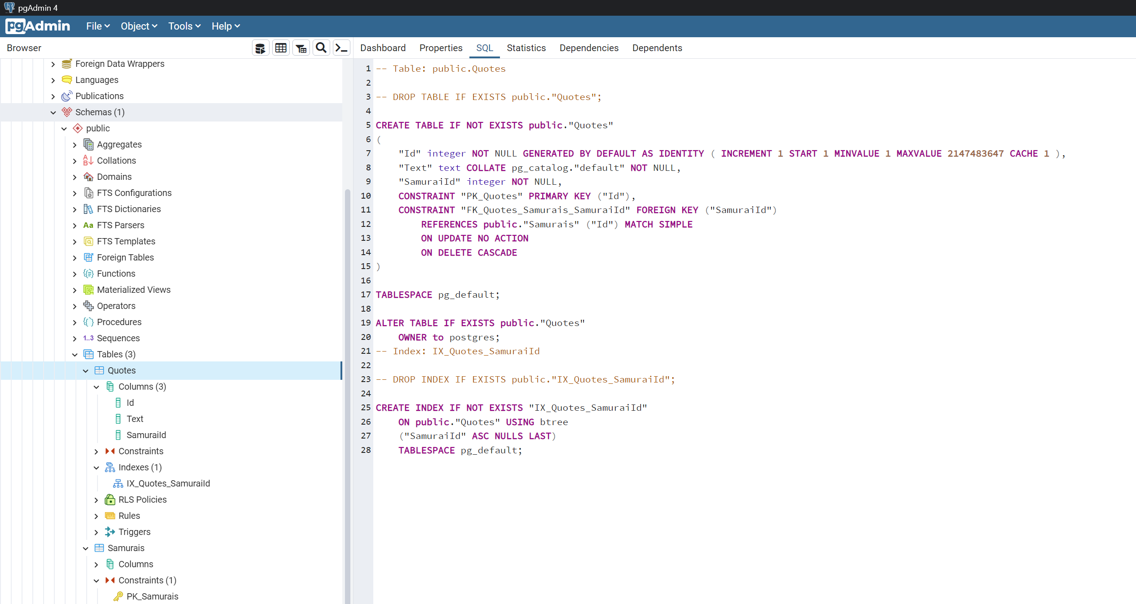
1: * CONSTRIANTS -2

Slide 46
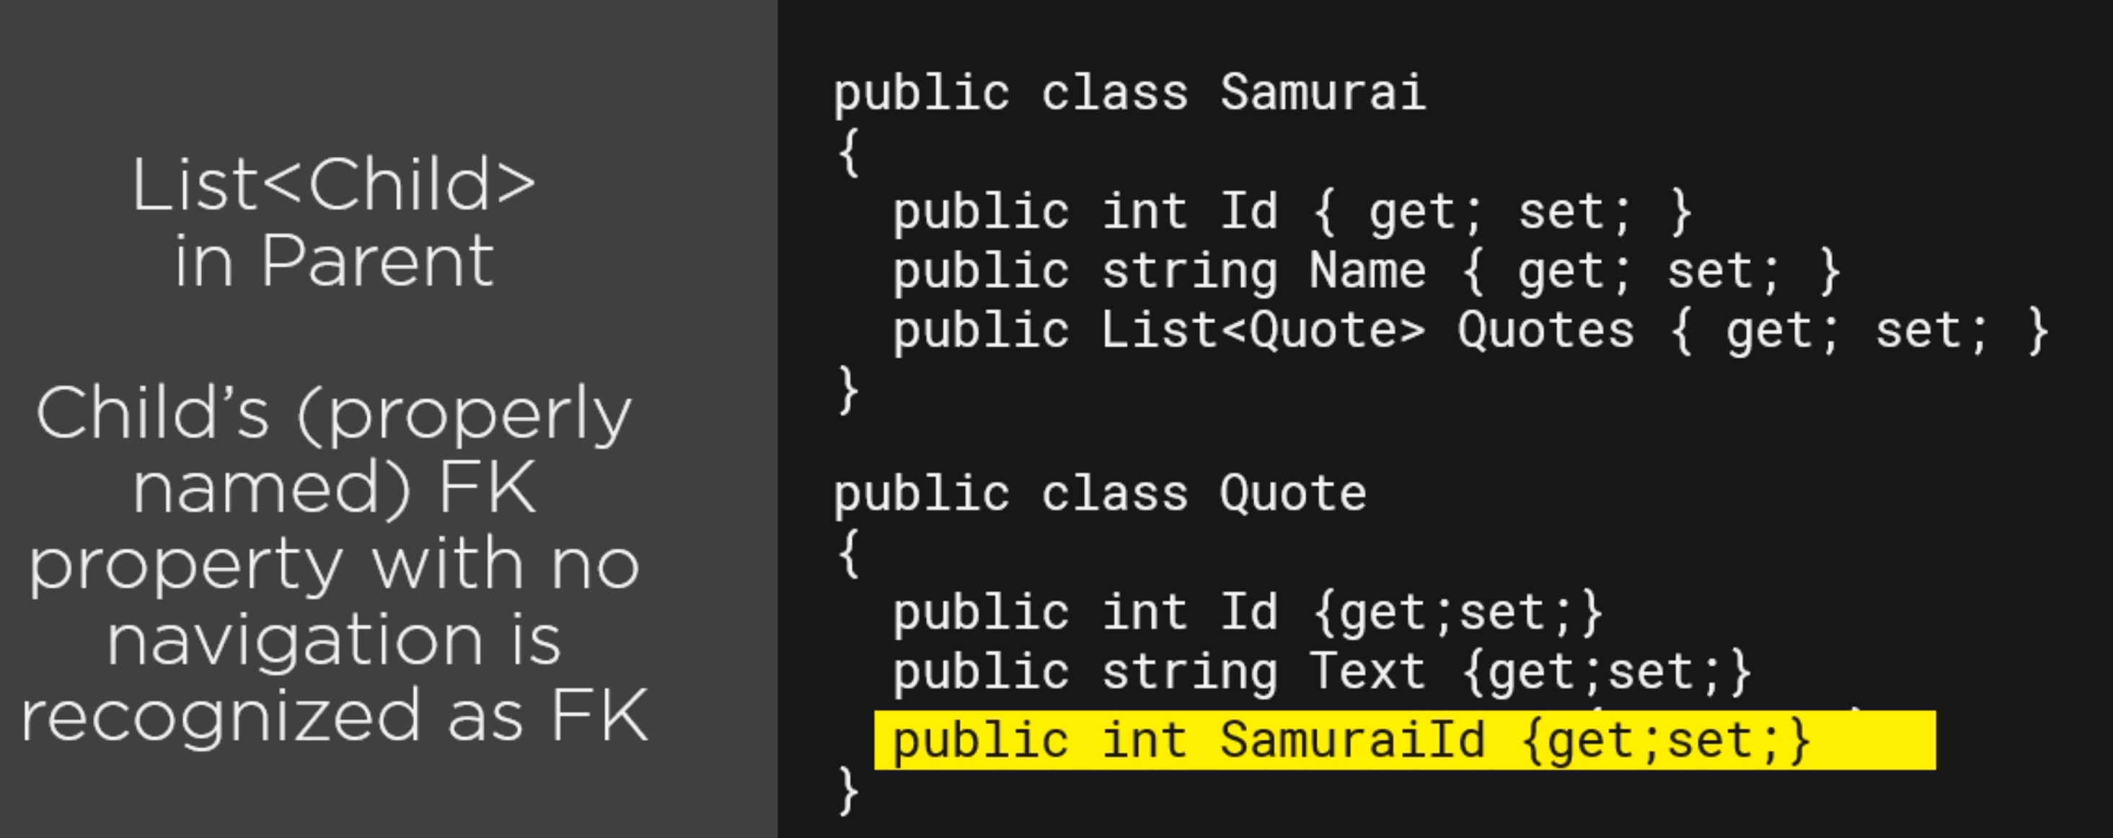
1: * Relation TYPE 4
int is not nullable by default. Therefore a quote can’t exist without Samurai.

Slide 47
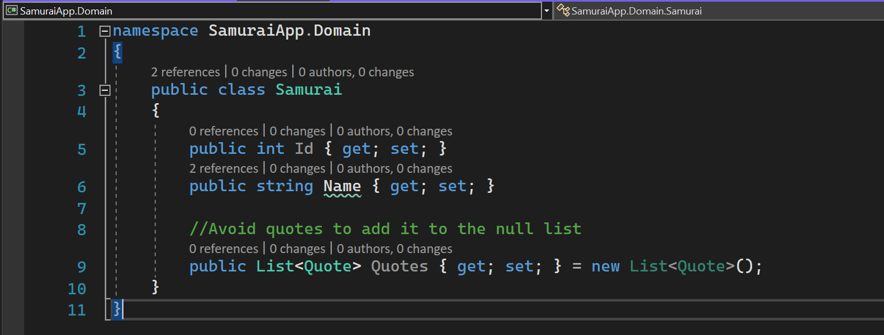
1: * Relation TYPE 4-1

Slide 48
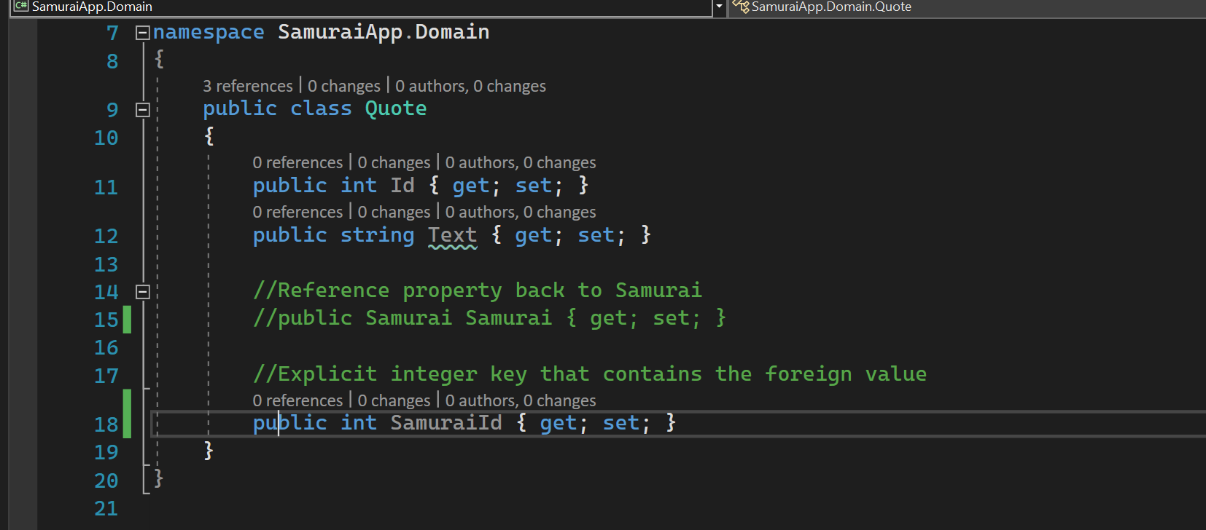
1: * Relation TYPE 4-2

Slide 49
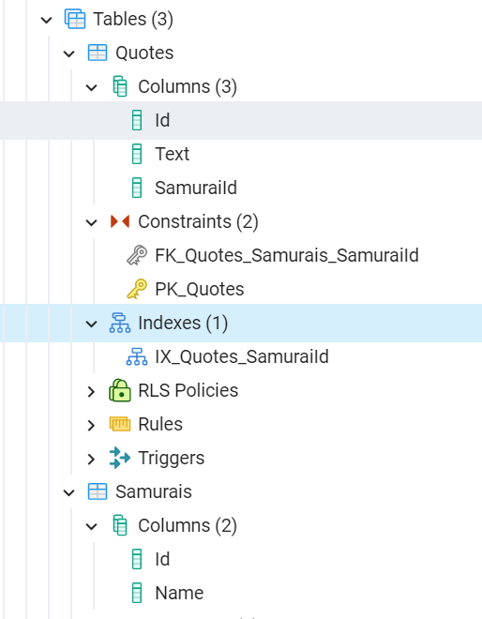
1: * Constraints - 1

Slide 50
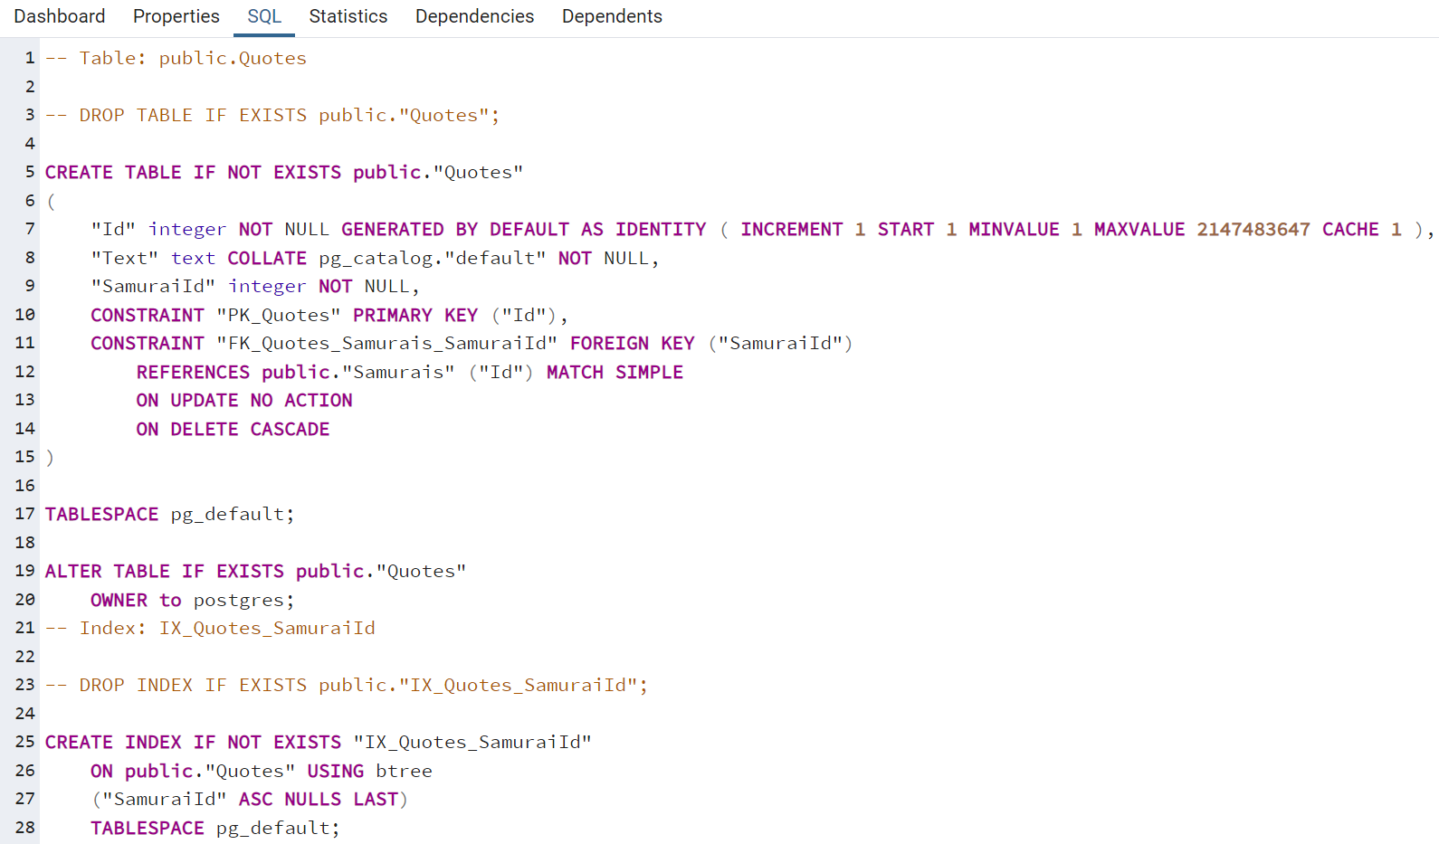
1: * Constraints - 2

Slide 51
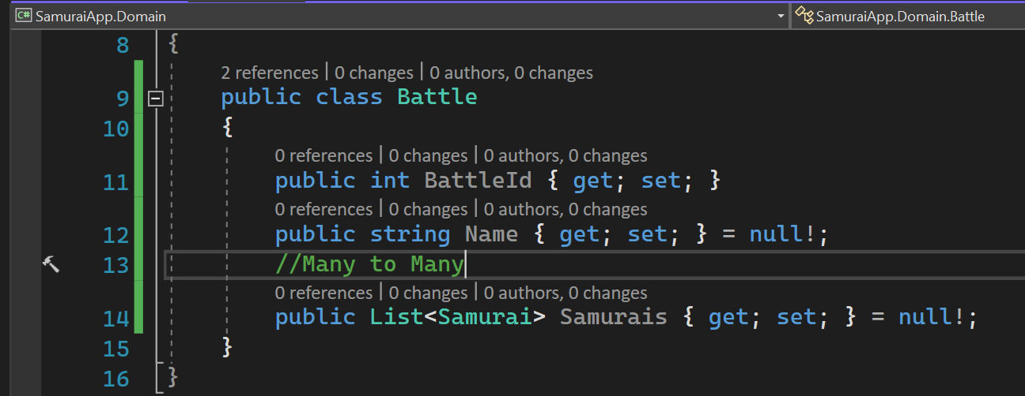
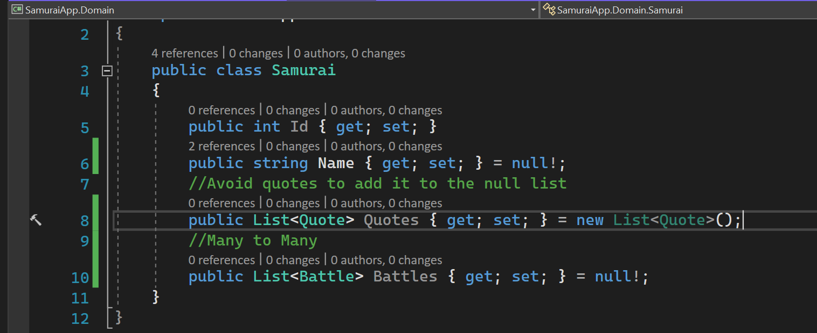
Many to many with skip navigations - 1

Slide 52
Many to many with skip navigations - 2
Under the covers, database will have join table called BattelSamurai.

Slide 53
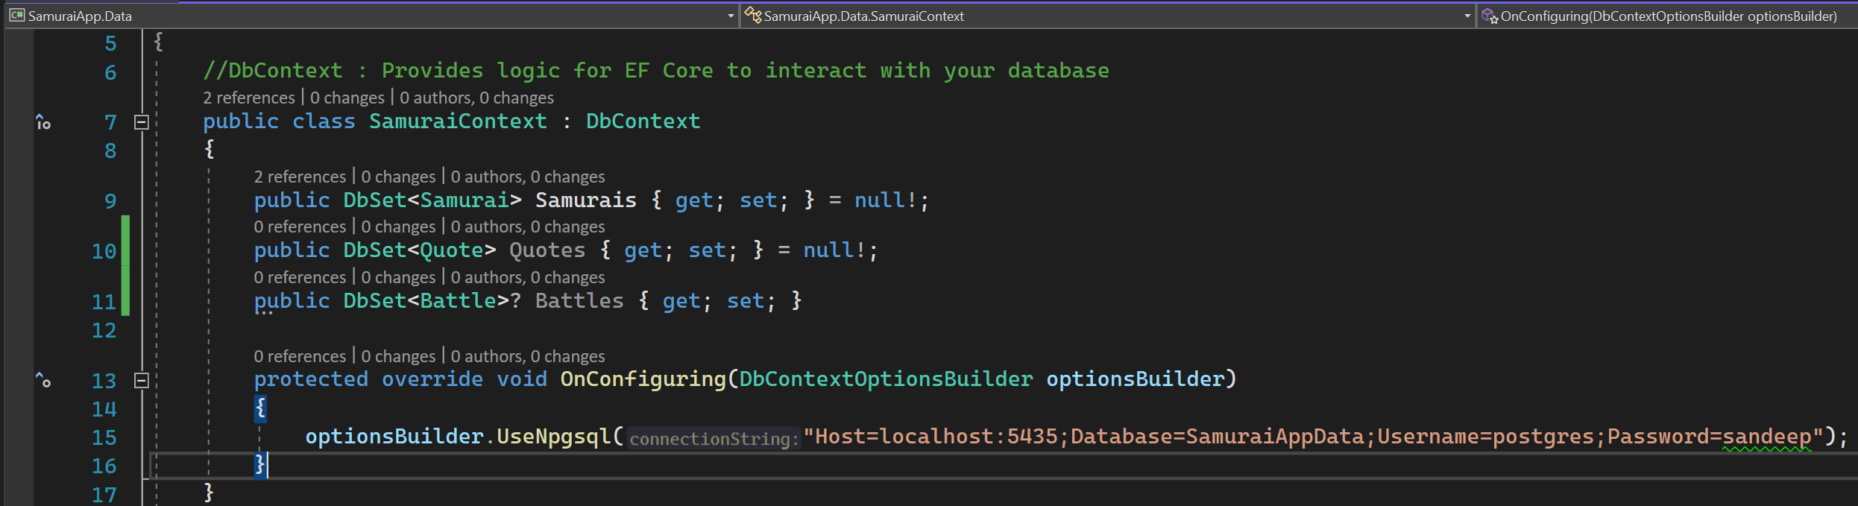
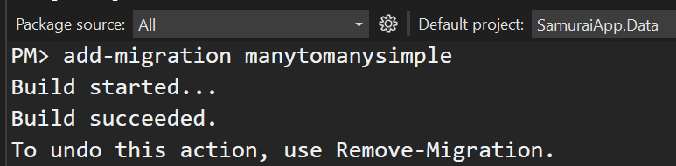
Add Battle context

Slide 54

Many to many with skip navigations - Constraints

Slide 55
EF CORE – MANY TO MANY RELATIONSHIPS – More details
https://www.codemag.com/Article/2010042/EF-Core-5-Building-on-the-Foundation

Slide 56

PAYLOAD
Need to configure the dbcontext to understand this mapping.

Slide 57

Configure many to many with payload
Express *:* using HasMany/With Many
End #1 HAS MANY END #2s vis the list navigation property.
That other end also is WITH MANY of End1, represented by the E1 list property.
Start with either end. There is no difference,

Slide 58

Add migration - 1

Slide 59

Add migration - 2
modelBuilder.Entity<BattleSamurai>()
.Property(bs => bs.SamuraiId).HasColumnName(“SamuraisId”);

Slide 60

Add migration - 3

Slide 61

Add migration - 4

Slide 62
Fluent – Override with totablemapping
modelBuilder
.Entity<BattleParticipant>()
.ToTable(“BattleSamurai”);

Slide 63


Get-migration
The equivalent command is dotnet “ef migrations list”.

Slide 64

CONSTRAINTS

Slide 65

One to one relationship - 1

Slide 66

One to one relationship - 2
Dependent end of 1 to 1 is always optional
Dependent child should always have parent.

Slide 67

Add-migration

Slide 68

Update database

Slide 69

EF CORE POWER TOOLS
Prerequisite – DGML Editor.
EF Core Power Tools relies on Microsoft.EntityFrameworkCore.Design

Slide 70

Install EF CORE POWER TOOLS - 1

Slide 71

Install EF CORE POWER TOOLS - 2

Slide 72

Generate DGML

Slide 73

DGML DIAGRAM

Slide 74
ExTRAS

Slide 75

Temporal tables

Slide 76
dotnet

Slide 77

Dotnet tool

Slide 78


Migration bundle

